Slide 1
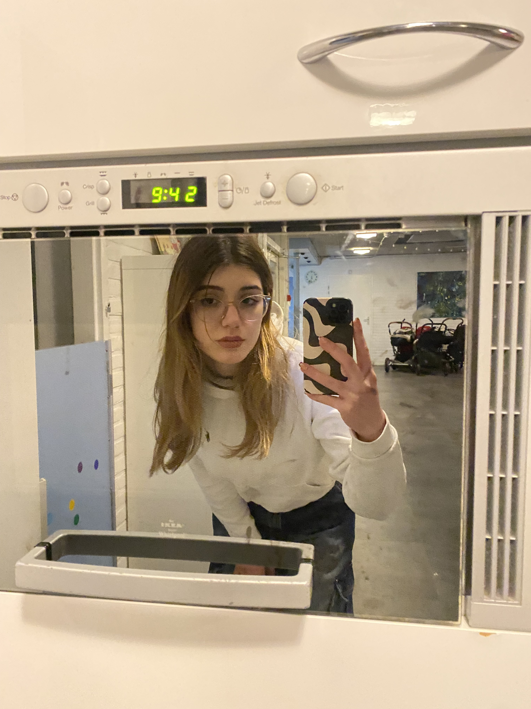
«Daria Elena Vlăduțu»
«236578»
«FAI1.P1-01_2023»
RETAKE
[photo]
Learning Log
«2023-2024» «C»
Design by Marvin Damstra

Slide 2

How To Use
This Template
As a student at Breda University of Applied Sciences studying to become a professional, you are required to provide evidence that demonstrates your professional learning and growth during the block. This template is intended to provide you with a well-structured and organised format for doing this effectively. Keep in mind that certain competencies may require you to update your evidence every week, and others may have only be relevant during a particular week or two.
With the evidence you present here teachers should get a clear and comprehensive overview of your progress, how you’ve engaged with feedback, as well as your general attitude and performance as a student and as an aspiring professional developer.
Note that number and size of text boxes and how they are organized on each slide may be modified as needed. It is up to you to decide what layout is most effective for the content you are providing. You may also add slides if needed, but try to be as economical as possible, i.e. quality over quantity. Focus on the things that are the most significant and meaningful.
You are also free to stylise this template to improve the graphic design and visual appeal, but please remember its purpose: to provide evidence of your progress towards becoming a professional developer. Changes should only enhance and extend the information, and may never subtract. I.e. do not delete anything or change the order of things. If in doubt, seek approval from your teachers!

Slide 3
Learning Log Structure Section A Starting this block Goals Section B Week log section Section C ILO section Section D Block reflection
Section A - My Plan
Must be completed in week 1
Your plan describes your goals for the block. Starting with where you are right now, where do you want to be at the end of the block? I.e. what role(s) will you take responsibility for, and how will you demonstrate progress relevant to the ILOs for this block? What tasks and deliverables are best aligned with your role and the project brief?
Section B - Weekly Log Must be updated every week
This is simply a log (journal) of what you do each day, and what you learn from it. It is your responsibility to update this regularly and frequently. Be sure to include working links to any specific evidence you are referencing (and make sure that you share your docs with the teaching team). Note: some of the required information may be captured in production documents such as your work log or peer reviews.
In such cases, you simply need to provide links to those artifacts and may include any explanatory comment or reflection you feel is appropriate.
(Some reflection is almost always a good idea as it provides the foundation for Section D.)
Section C - ILO’s Must be completed in week 8, but should be updated regularly.
This is where you link your evidence to each of the Intended Learning Outcomes of this block.
Section D – Reflection Must be completed in week 8
Summative reflection on your progress during the block including a critical assessment of everything you did and learned during the block. This is a comprehensive review of everything recorded in Section B, evaluated against the goals and planning laid out in Section A.

Slide 4
Section A
Not relevant this block! Becomes relevant in Block D!
A
Goal Setting

Slide 5
Section B
B
Progress Log
Notes:
MUST BE UPDATED EVERY WEEK
This is simply a log (journal) of what you do each day, and what you learn from it. It is your responsibility to update this regularly and frequently. Be sure to include working links to any specific evidence you are referencing (and make sure that you share your docs with the teaching team). Note: some of the required information may be captured in production documents such as your work log or peer reviews.
In such cases, you simply need to provide links to those artifacts and may include any explanatory comment or reflection you feel is appropriate.
(Some reflection is almost always a good idea as it provides the foundation for Section C.)

Slide 6
1
Week 1 - Log
1/3
What did you do?
Reflection
What goal(s) did you set for this week?
Be efficient in my work and complete the tasks on time;
Update my learning and work log regularly;
Finish the book ‘The subtle art of not giving a f**k’ by Mark Manson;
Learn about responsible AI in the context of the dataset that I will be using;
Creating a dataset;
Coming up with a business problem;
What have you actually been able to do?
I have been able to complete my tasks almost on time.
I did not manage to finish the book this week because it is a self-help book and I wanted to read more fiction.
I have updated both my learning and work logs regularly.
I did manage to create a dataset. However, it is a bit incomplete in my opinion.
How did the week go?
The week went by quickly. By the time I realised it was Friday, I still thought yesterday was Wednesday!
What went well?
I started off with a positive attitude towards this block and I did not feel burnt out as quickly.
The weather is getting nice again.
What didn’t go so well?
I had some problems with the creation of my dataset as the code did not want to run (I am working on a mac). However, I did manage to partly fix it. When I run the code it still doesn’t scrape all the images I want in a particular category, or it doesn’t distribute them evenly. I also had problems with the images it was downloading because they did not want to open.
What did you learn?
I learned what individual and group fairness are, and about explicit and implicit bias, and how these concepts are very important in the field of AI.
I conducted research in the bar and restaurant field and decided on a business problem my algorithm would try to solve.
What could be added as an Action point looking forward to next week?
I want to be able to do extra school work next week.

Slide 7
1
Week 1 - Feedback
2/3
Team, individual, peer, workshop feedback
[Edirlei Soares de Lima] The DAPS diagram looks good. If you have multiple classes which the model will predict, make sure to put them in a singular rectangle separated by a comma; Make sure to upload your dataset to the OneDrive SharePoint and make the link public so we can access it; It is fine if you want to talk about bias found in the imSitu database, it doesn’t necessarily have to be a bias identified in your own; It is great if you want to put pictures in your notebook to evidence the bias.
Response to Feedback: I have modified my diagram accordingly and made the link in OneDrive. I made sure to make it public and to reference it in my WorkLog.

Slide 8
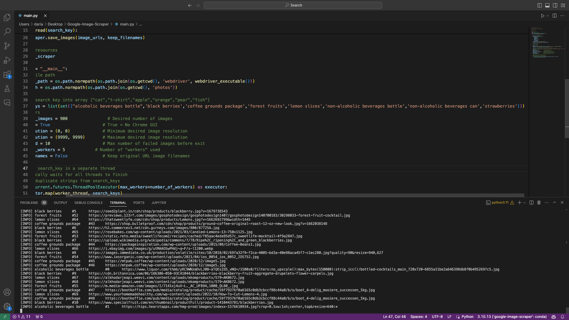
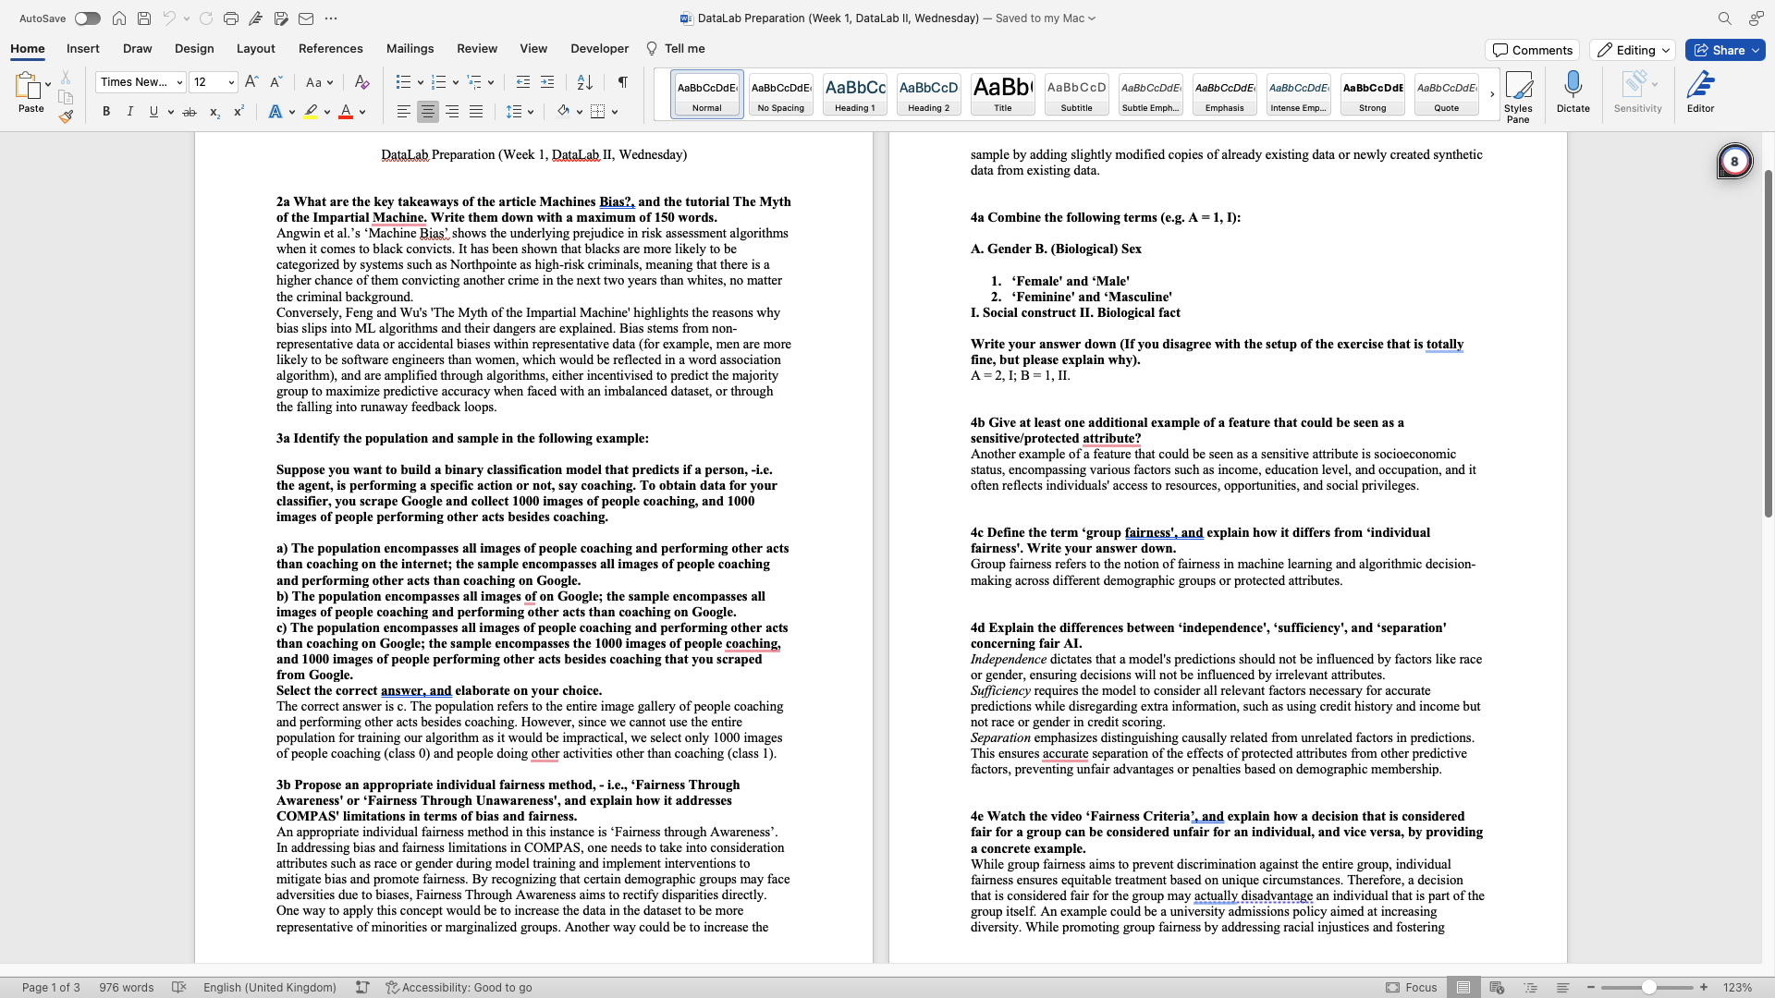
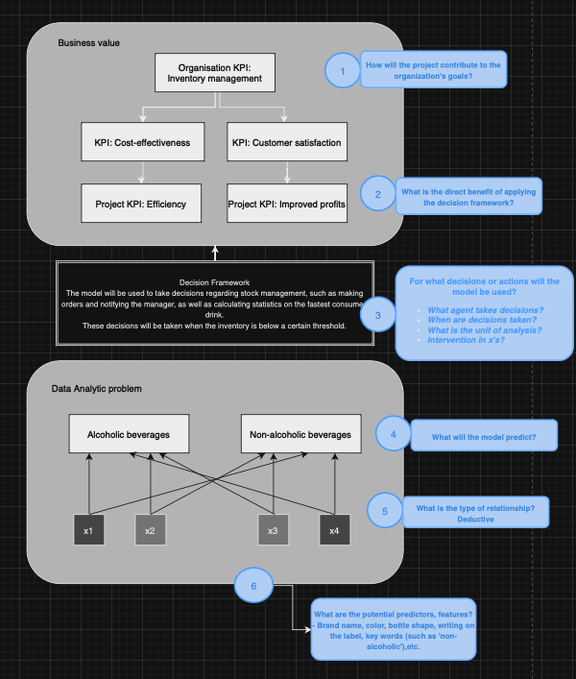
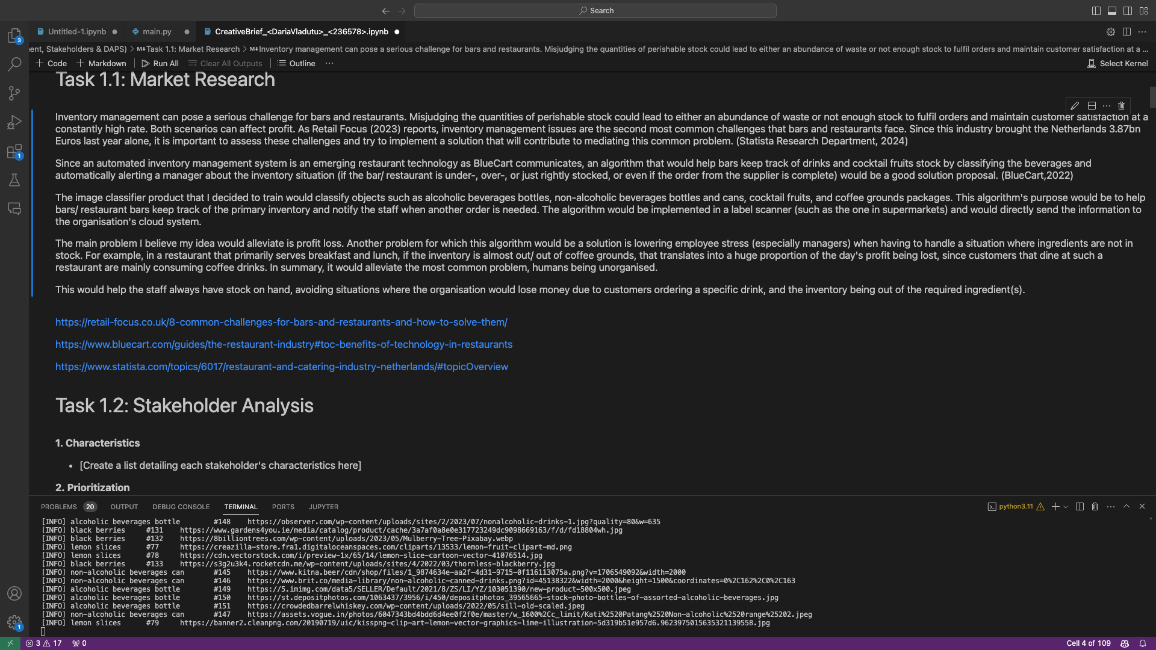
1
Week 1 - Evidence
3/3
DataLab Prep:
https://github.com/BredaUniversityADSAI/2023-24c-fai1-adsai-dariavladutu236578/blob/main/Week 1/DataLab Preparation (Week 1%2C DataLab II%2C Thursday).docx
Scraped my own dataset:
https://github.com/BredaUniversityADSAI/2023-24c-fai1-adsai-dariavladutu236578/blob/main/Deliverables/CreativeBrief_%3CDariaVladutu%3E_%3C236578%3E.ipynb
Started working on my creative brief deliverable:
https://github.com/BredaUniversityADSAI/2023-24c-fai1-adsai-dariavladutu236578/blob/main/Deliverables/CreativeBrief_%3CDariaVladutu%3E_%3C236578%3E.ipynb
My DAPS diagram:
https://github.com/BredaUniversityADSAI/2023-24c-fai1-adsai-dariavladutu236578/blob/main/Week 1 - Responsible AI/DAPS DIAGRAM.png

Slide 9
2
Week 2 - Log
1/3
What did you do?
Reflection
What goal(s) did you set for this week?
Stay on top of my school work.
Make sure to read the extra material and understand the concepts.
Ask my mentor to clarify information if I have questions.
What have you actually been able to do?
I have been up to date on everything and completed the quizzes on time.
I had a talk with my mentor about everything that was unclear and I asked my classmates for help when needed.
How did the week go?
The week went by fast. It was a really productive week, which I liked.
What went well?
I managed to organise my time well and be productive.
What didn’t go so well?
I had trouble at the beginning of the week understanding the material but by the end I caught up and my mentor cleared everything up.
It was a bit difficult to manage my time by the end of the week because of work, but I stayed organised in the end.
What did you learn?
I learned about the Keras library and the TensorFlow platform.
I learned about classification and regression algorithms, and what kind of metrics to use in order to evaluate them.
I learned what the underlying mechanism of ML classification algorithms are.
What could be added as an Action point looking forward to next week?
Keep my momentum going.

Slide 10
2
Week 2 - Feedback
2/3
Team, individual, peer, workshop feedback
[Reviewer] Feedback
Response

Slide 11
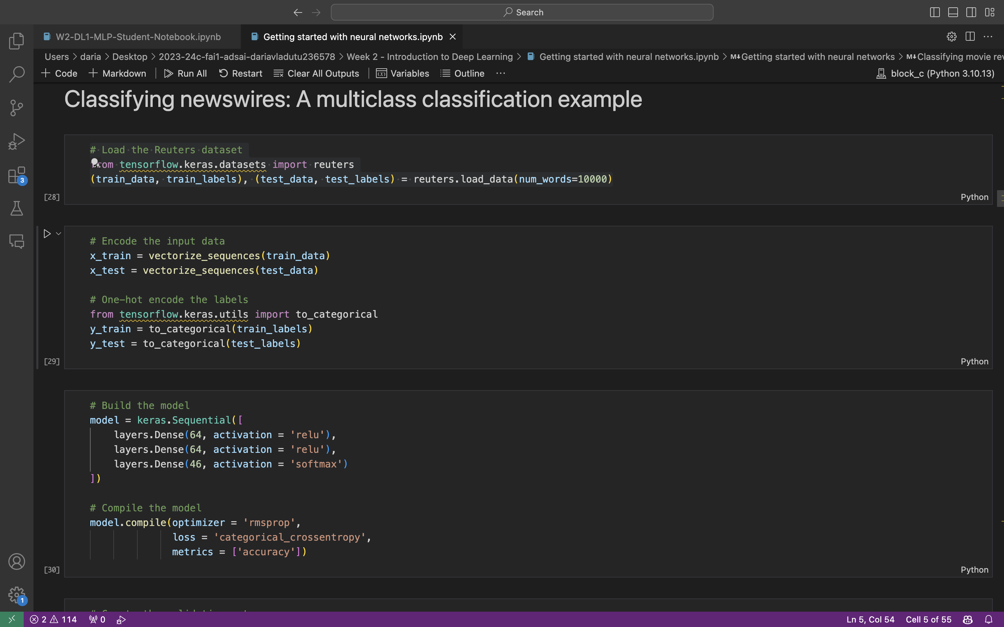
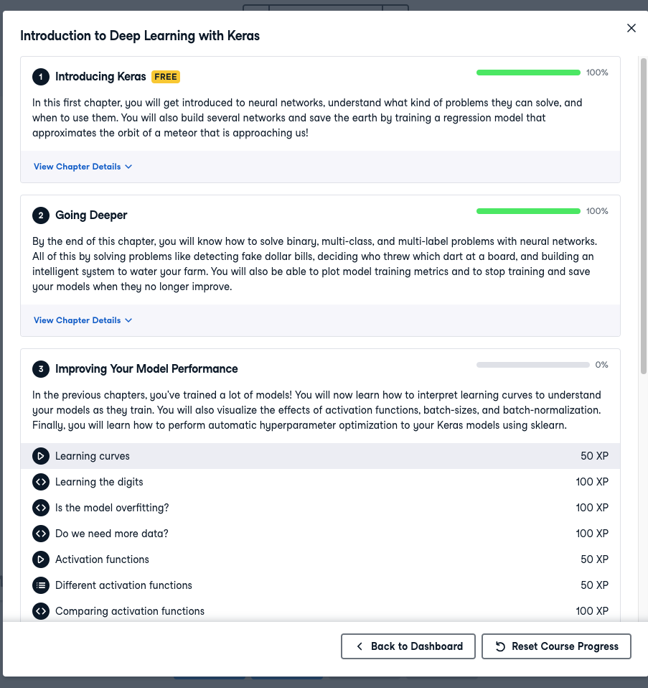
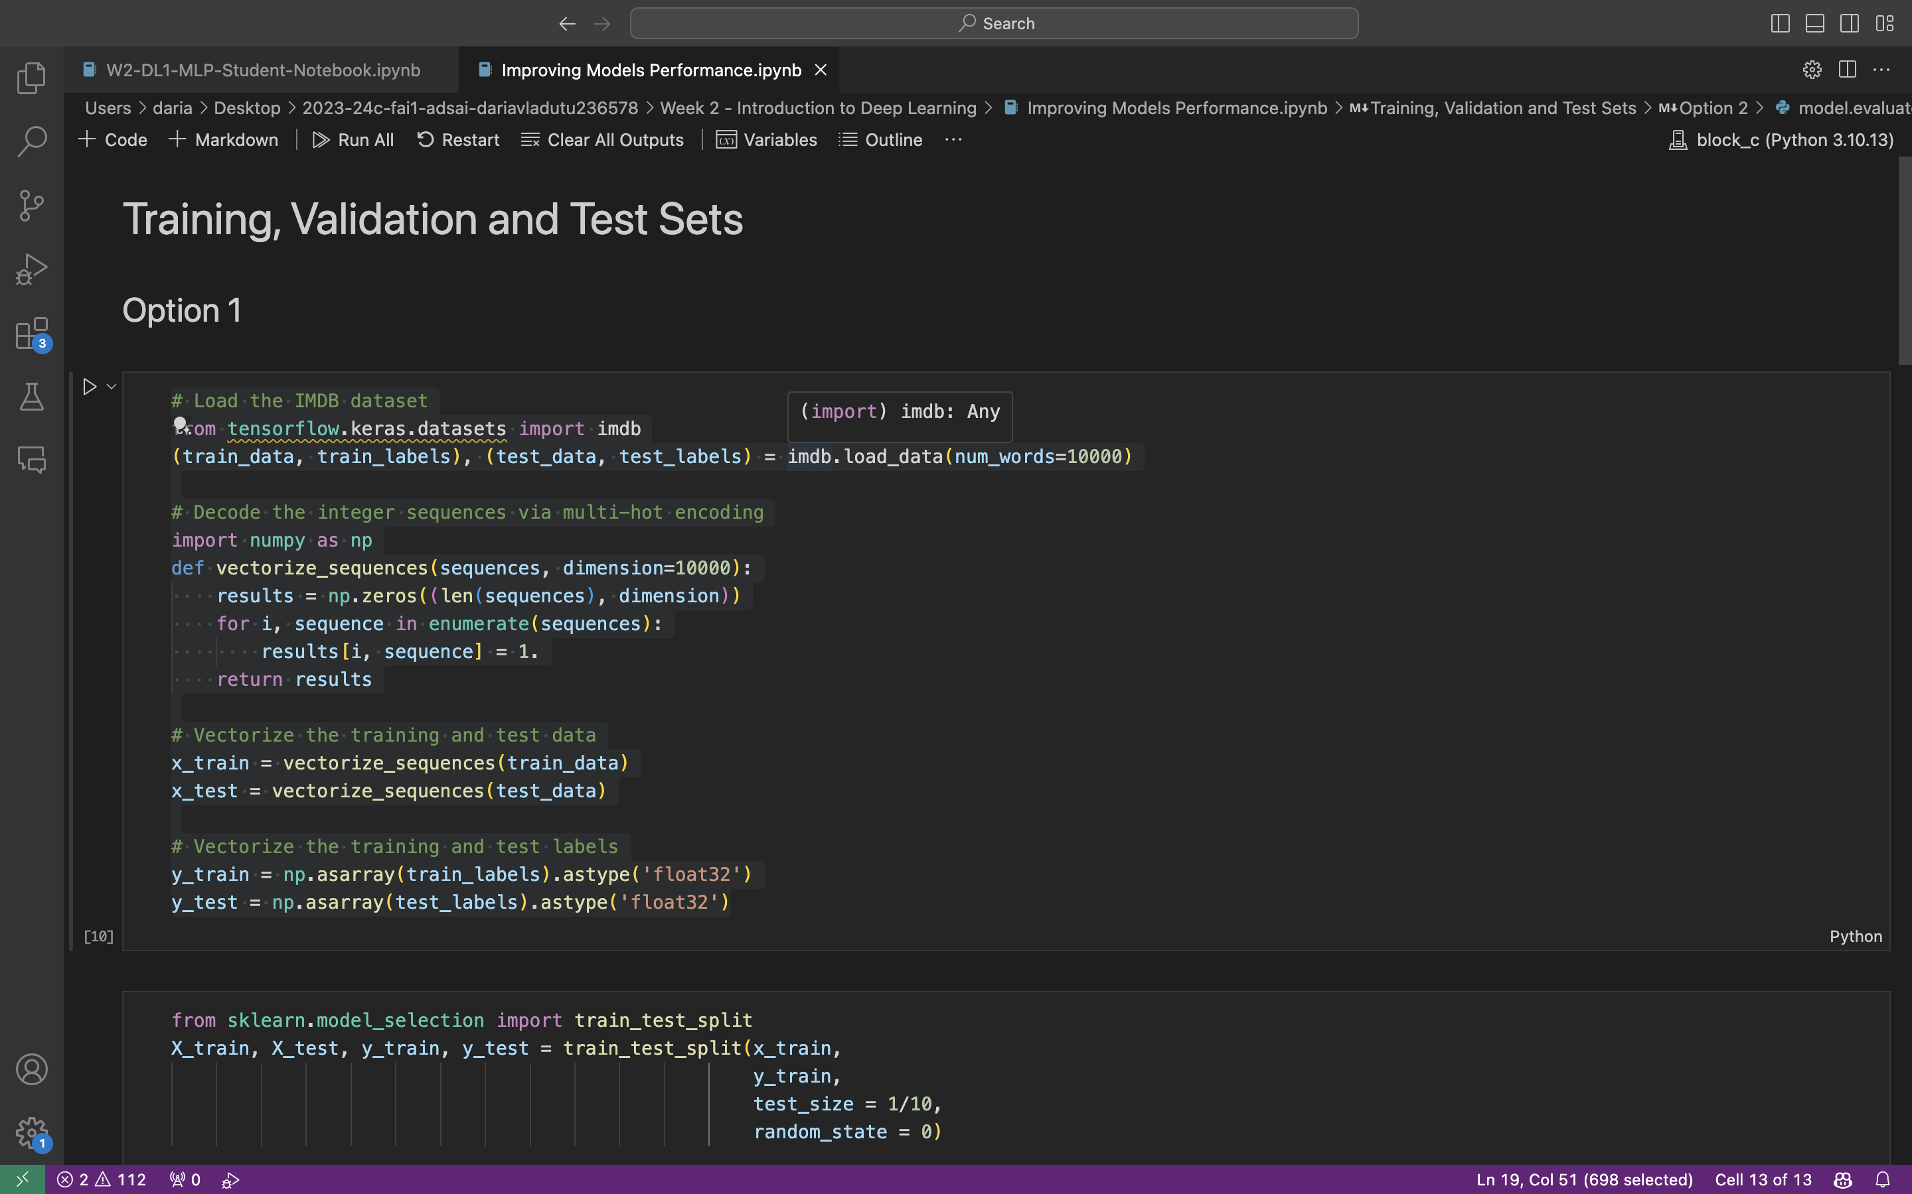
2
Week 2 - Log
3/3
DataLab I notebook:
https://github.com/BredaUniversityADSAI/2023-24c-fai1-adsai-dariavladutu236578/blob/main/Week 2 - Introduction to Deep Learning/W2-DL1-MLP-Student-Notebook.ipynb
Introduction to DL with Keras (first 2 chapters)
https://github.com/BredaUniversityADSAI/2023-24c-fai1-adsai-dariavladutu236578/blob/main/Week 2 - Introduction to Deep Learning/Introduction to Keras CH1 %2B CH2.png
DataLab II notebook:
https://github.com/BredaUniversityADSAI/2023-24c-fai1-adsai-dariavladutu236578/blob/main/Week%202%20-%20Introduction%20to%20Deep%20Learning/Improving%20Models%20Performance.ipynb

Slide 12
3
Week 3 - Log
1/3
What did you do?
Reflection
How did the week go?
The week went really well. The material was really well organised and I was really motivated to learn about and implement neural networks.
What went well?
My motivation was really high and I was very productive with my work.
I completed the tasks for the week, as well as caught up with some readings from Week 2 (Chapter 3 from the book “Deep Learning with Python” by François Chollet)
What didn’t go so well?
I didn’t fully understand gradient descent in the context of NN.
What did you learn?
Learned about perceptrons, sigmoid neurons, and more about the neural network used to classify handwritten digits.
Calculated the output of a multilayer perceptron by hand.
Got acquianted with the task at hand of building an MLP from scratch, and created a function which returns random values for weights and biases for any given neural network architecture.
Learned more about the ML project lifecycle, as well as understood how to optimize each step of the process.
What could be added as an Action point looking forward to next week?
Try to work in advance to free up time.
What goal(s) did you set for this week?
Understand neural networks and how they work
Read all chapters for this week from the book “Deep Learning with Python” by François Chollet
Build an MLP from scratch
Do all of the DataLab Prep quizzes on time
What have you actually been able to do?
I read all required chapters
I completed all DataLab Preps on time and spent extra time making sure I fully understand them
I did not manage to construct the whole multilayer perceptron from scratch; I asked for help from my peers and mentor
I understood how neural networks work and how outputs are calculated

Slide 13
3
Week 3 - Feedback
2/3
Team, individual, peer, workshop feedback
[Reviewer] Feedback
Response

Slide 14
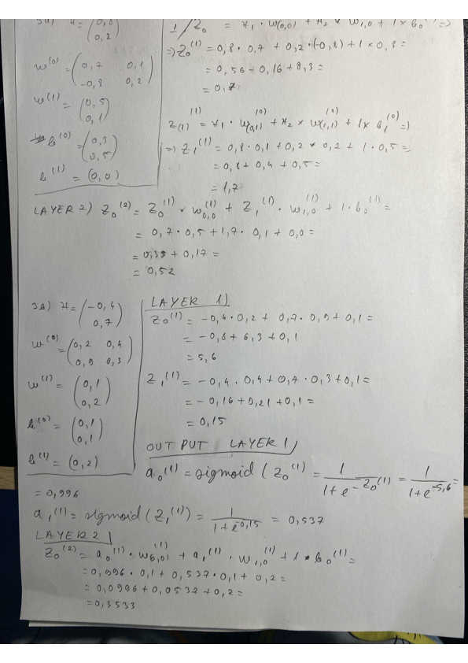
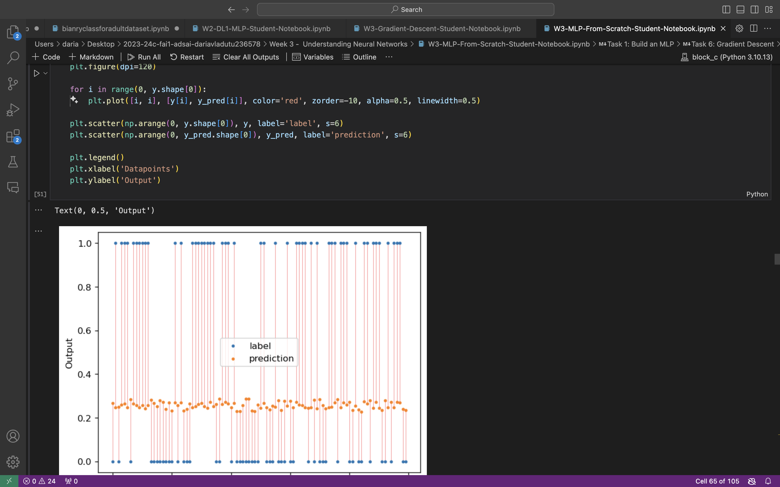
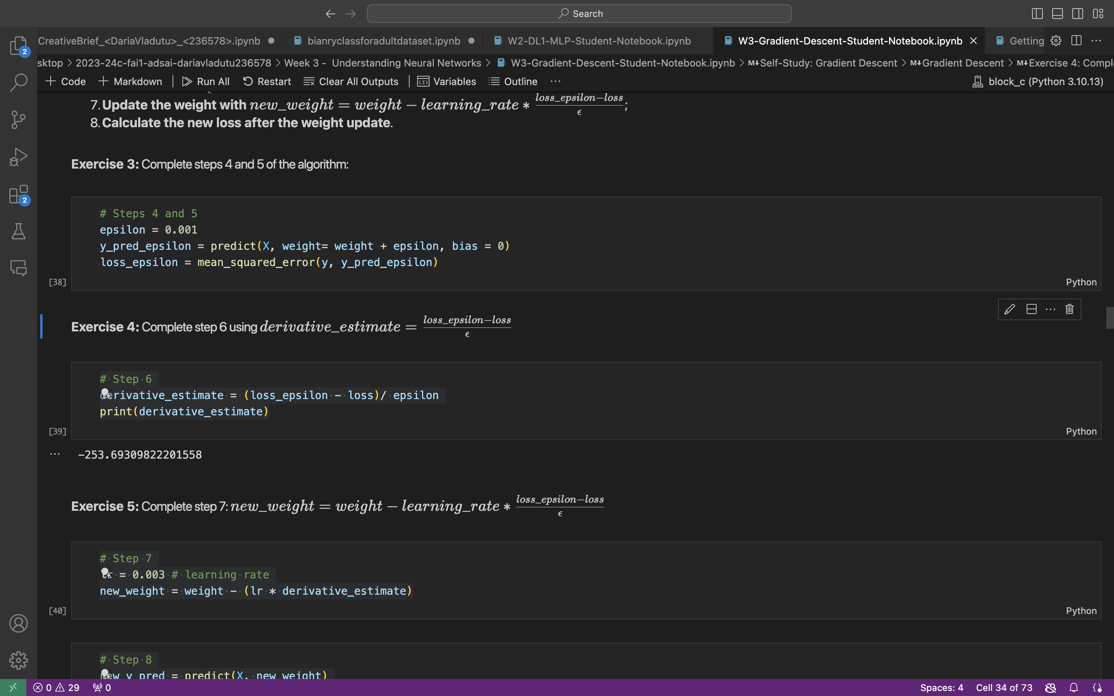
3
Week 3 - Evidence
3/3
Calculating the output of an MLP by hand:
https://github.com/BredaUniversityADSAI/2023-24c-fai1-adsai-dariavladutu236578/blob/main/Week 3 - Understanding Neural Networks/Monday quiz 3a and 3b.pdf
MLP from scratch:
https://github.com/BredaUniversityADSAI/2023-24c-fai1-adsai-dariavladutu236578/blob/main/Week 3 - Understanding Neural Networks/W3-MLP-From-Scratch-Student-Notebook.ipynb
Learned about Gradient Descent:
https://github.com/BredaUniversityADSAI/2023-24c-fai1-adsai-dariavladutu236578/blob/main/Week 3 - Understanding Neural Networks/W3-Gradient-Descent-Student-Notebook.ipynb

Slide 15
4
Week 4 - Log
1/3
What did you do?
Reflection
What goal(s) did you set for this week?
Submit all DataLab Preparations on time
Read and understand chapters 7 and 8 from DLP book
Work on DataLab Tasks in the Creative Brief
Work on presentation
What have you actually been able to do?
I have submitted all the DL preps on time and put effort into answering in a good manner
I read and understood all the required chapters
I worked on DataLab Tasks in the Creative Brief
How did the week go?
The week was really tiring due to the workload amount, but I managed to stay on track with most of my goals.
What went well?
I really enjoyed the material for this study week. It was interesting and it kept me motivated.
What didn’t go so well?
I didn’t manage to work on as many DataLab Tasks from the Creative Brief as I would have liked. I only managed to catch up with task 2.5.
What did you learn?
Understood the term 'convolutional', what kernels are, how they work, and how to apply filters (sharpening and Gaussian) to images.
Exercised applying the knowledge learned about convolutions (created kernels, applied convolutional operation horizontally and vertically, applied sharpening and Gaussian filters).
Learned abput the Sequential model, the Functional API and Model subclassing; Learned about training and evaluation loops, callbacks to customise training, and writing training and evaluation loops from scratch.
Further comprehension of the concepts of convolution, padding and max-pooling, and how CNNs work, are built, and what they are useful for.
Learned how to generate modified versions of existing data, such as flipping the image horizontally or vertically, rotating the image by a certain degree, cropping the image to a different aspect ratio, adding noise or blur to the image; Exercised the knowledge on a photo from my own dataset
Learned about leveraging a pretrained model using feature extracting and fine-tuning
What could be added as an Action point looking forward to next week?
I need to set more time aside to catch up with the creative brief.

Slide 16
4
Week 4 - Feedback
2/3
Team, individual, peer, workshop feedback
[Reviewer] Feedback
Response

Slide 17
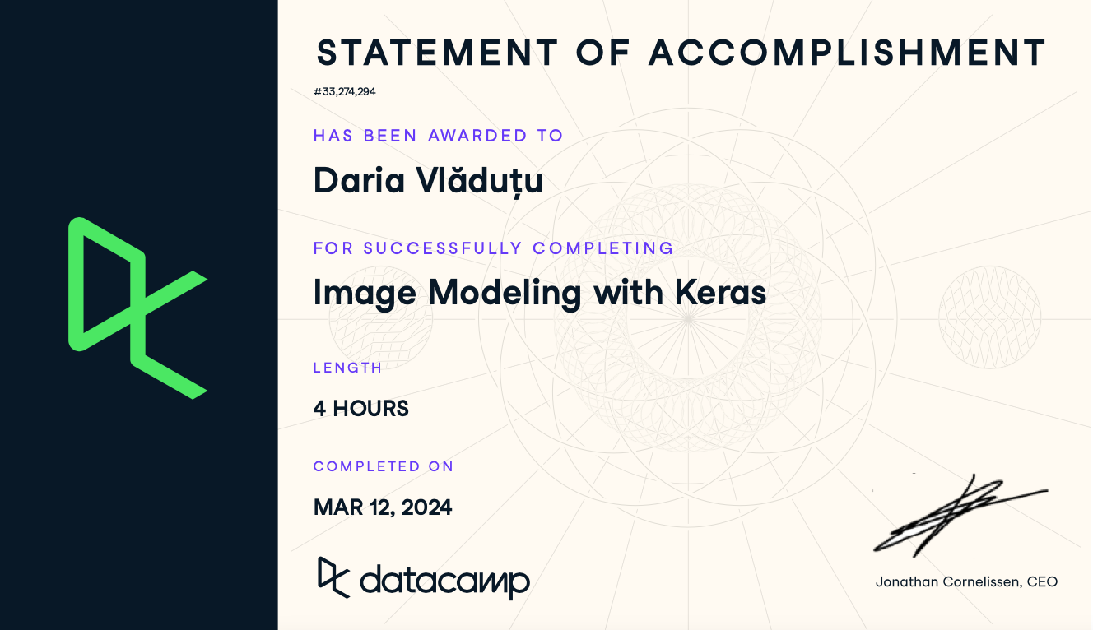
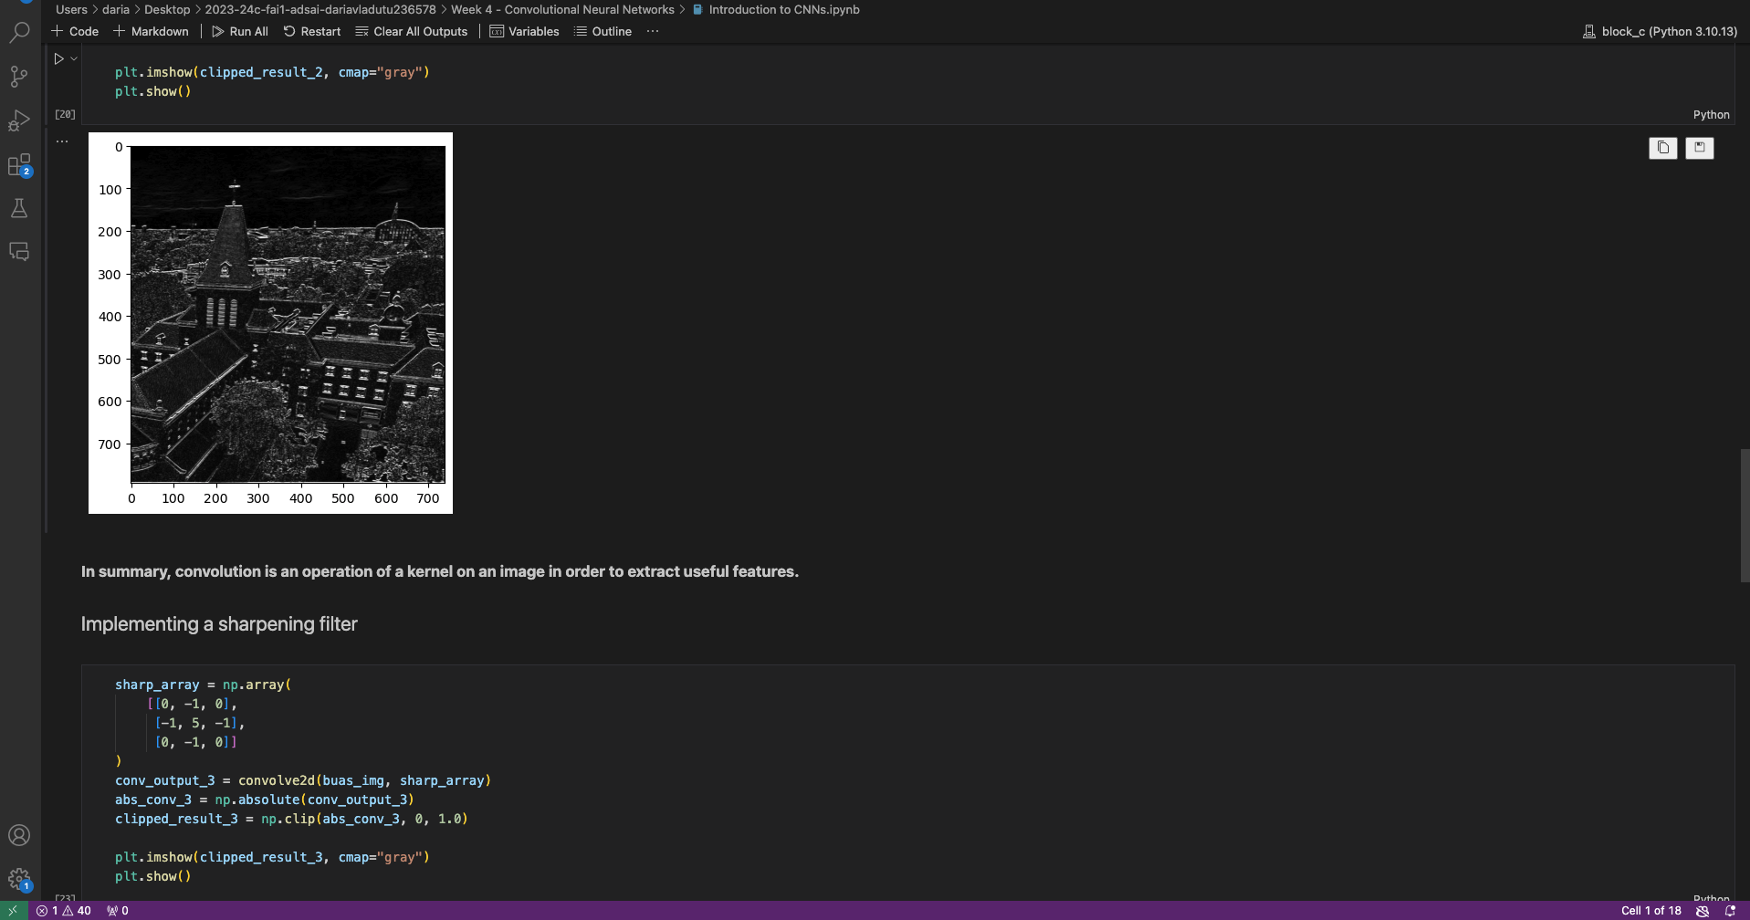
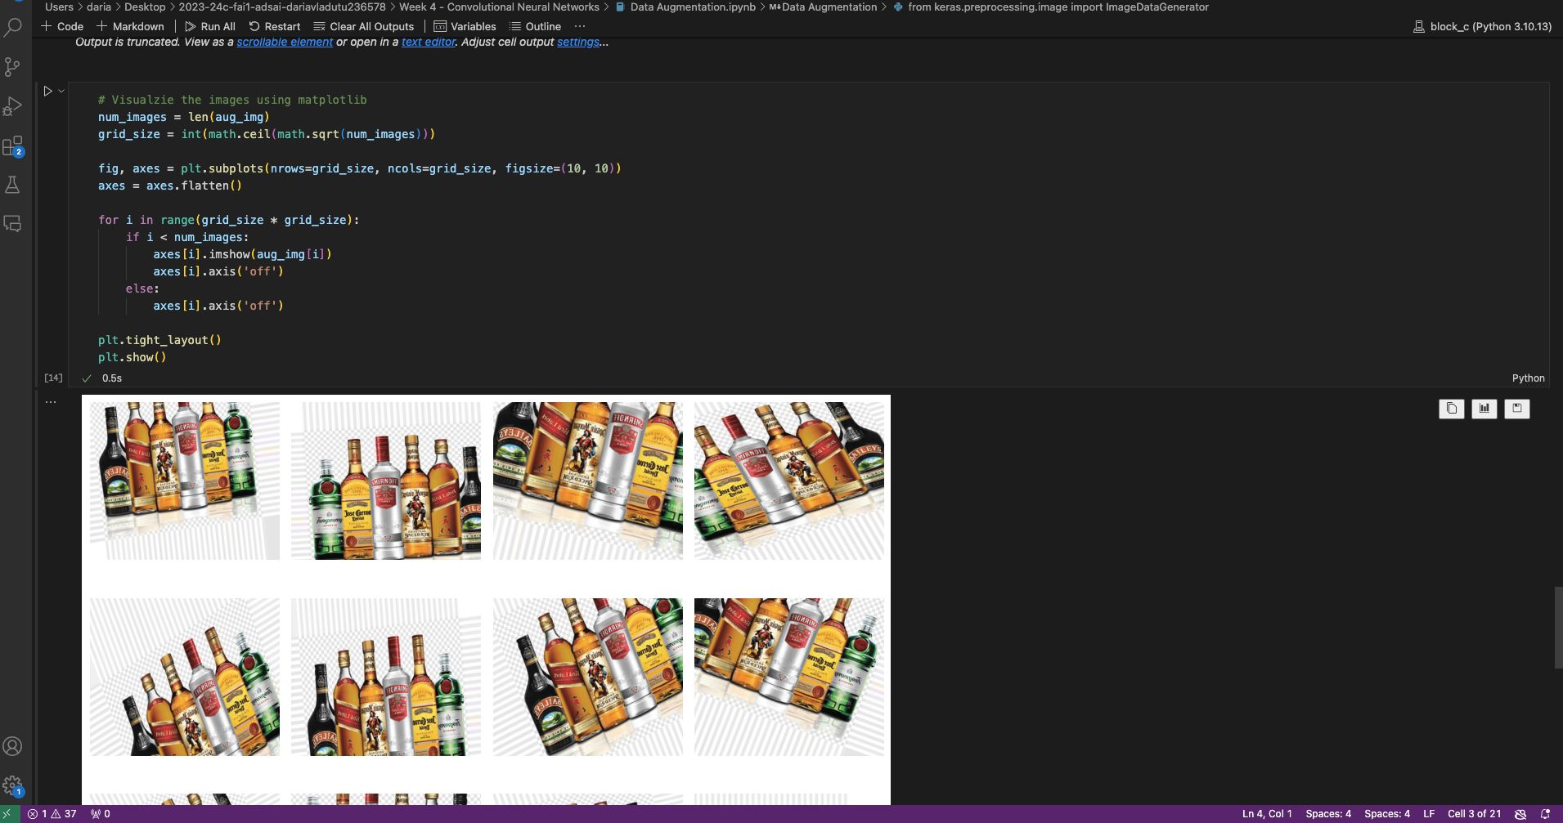
4
Week 4 - Evidence
3/3
Image Modeling with Keras course:
https://github.com/BredaUniversityADSAI/2023-24c-fai1-adsai-dariavladutu236578/blob/main/Week 4 - Convolutional Neural Networks/Image Modeling with Keras.pdf
https://github.com/BredaUniversityADSAI/2023-24c-fai1-adsai-dariavladutu236578/blob/main/Week 4 - Convolutional Neural Networks/Introduction to CNNs.ipynb
Introduction to CNNs:
Data Augmentation:
https://github.com/BredaUniversityADSAI/2023-24c-fai1-adsai-dariavladutu236578/blob/main/Week 4 - Convolutional Neural Networks/Data Augmentation.ipynb

Slide 18
5
Week 5 - Log
1/3
What did you do?
Reflection
How did the week go?
The week went by without any major remarks. I liked the material we studied for this week.
What went well?
I understood the material quite well and I envisioned how we would use it in a presumed future ML engineer career.
What didn’t go so well?
I was overwhelmed due to personal issues.
What did you learn?
Reviewed the stages of the machine learning project lifecycle.
Further comprehension of the ml project lifecycle stages (Scoping, Data, Modeling and Deployment).
Learned more about the modeling and deplpoyment phases of the cyclem such as challenges, how to establosh a baseline, how to properly measure the performance of the model, and how to get started, and the difference between s data-centric approach and a model-centric approach to ML development.
Created a form to calculate HLP using my own dataset.
Learned more about the error analysis phase of the modeling phase of the MLPL, such as identifying where to proritize work on improving model performance, analyzing said performance and using data-centric approaphes to improve performance, including performance auditing.
Learned about the importance of proper labeling and using human-level performance as a baseline for a ML project performance assessment.
Learned about the process of scoping in the context of machine learning, as well as about assessing feasibility and project value.
What goal(s) did you set for this week?
Learn about and understand how the Machine Learning Project Lifecycle works
Complete the YouTube course related to the MLPL
Complete the quizzes
Extensively work on the Creative Brief (Tasks 3.1 - 3.4)
Work on the Final Presentation
What have you actually been able to do?
I have worked on the Creative Brief (Tasks 3.1 – 3.3)
I understood the MLPL after completing the video course related to it
I completed all of the quizzes
I worked on the presentation and completed the first two slides.
What could be added as an Action point looking forward to next week?
I want to work on my presentation more

Slide 19
5
Week 5 - Feedback
2/3
Team, individual, peer, workshop feedback
[Reviewer] Feedback
Response

Slide 20
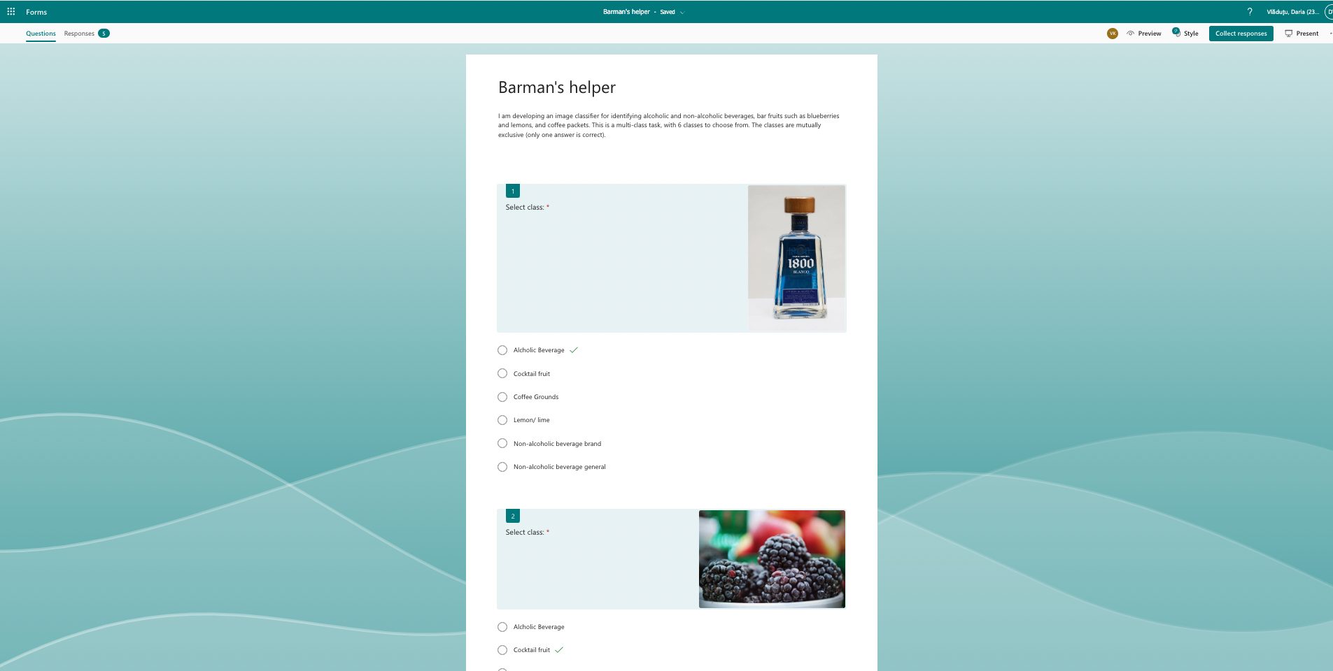
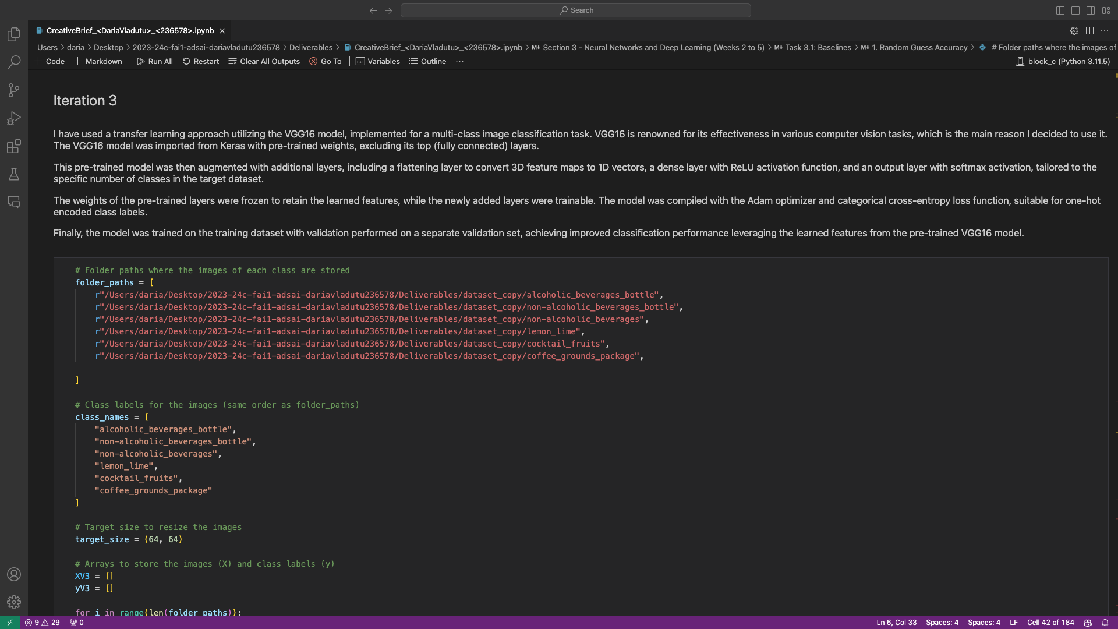
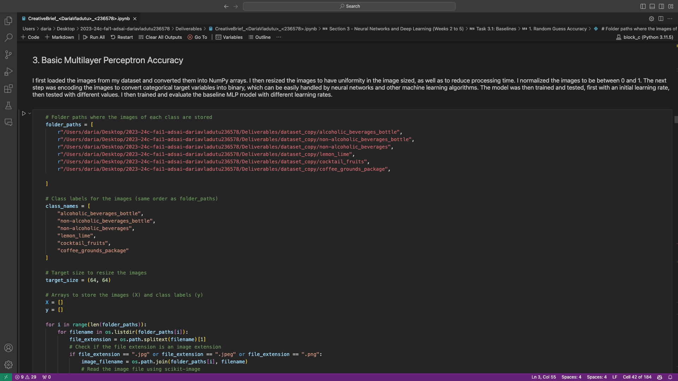
5
Week 5 - Evidence
3/3
Human-Level Performance Form
https://forms.office.com/e/Q4NNpKebS2
Creative Brief Tasks 3.1 - 3.4
https://github.com/BredaUniversityADSAI/2023-24c-fai1-adsai-dariavladutu236578/blob/main/Week 1/Datalab I (Task 2.1 and 2.2).docx

Slide 21
6
Week 6 - Log
1/3
What did you do?
Reflection
What goal(s) did you set for this week?
Learn about the trade-off between accuracy and interpretability when discussing responsible AI
Learn about gradient-based XAI methods
Learn about perturbation-based XAI methods
Complete the third iterations for all model versions
Start working on error analysis
What have you actually been able to do?
I have done everything I was planning to.
How did the week go?
The week went by quite fast
What went well?
I enjoyed the content that we got this week.
What didn’t go so well?
Workload wise, it was quite intensive, especially because the deadline is coming.
What did you learn?
XAI and Its Importance
Taxonomy of XAI
What is a ‘Good' Explanation’.
Vanilla Gradients
Integrated Gradients
Grad-CAM
Local Interpretable Model-agnostic Explanations (LIME)
Shapely Additive Perturbation (SHAP)
Adversarial Attacks and Counterfactuals
What could be added as an Action point looking forward to next week?
Try to get started early on finalizing the final deliverable.

Slide 22
6
Week 6 - Feedback
2/3
Team, individual, peer, workshop feedback
[Reviewer] Feedback
Response

Slide 23
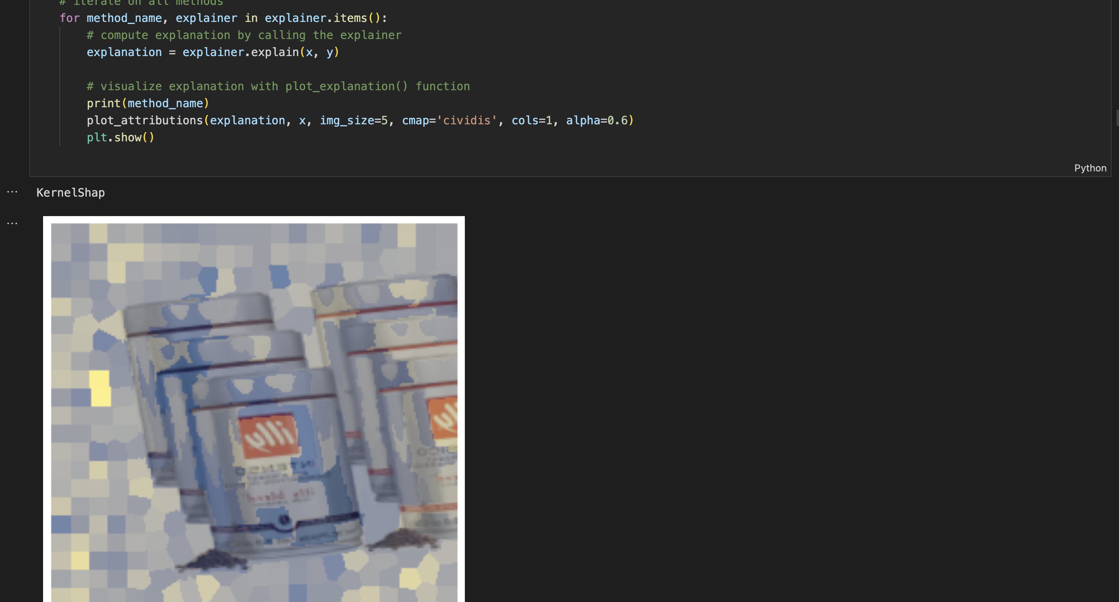
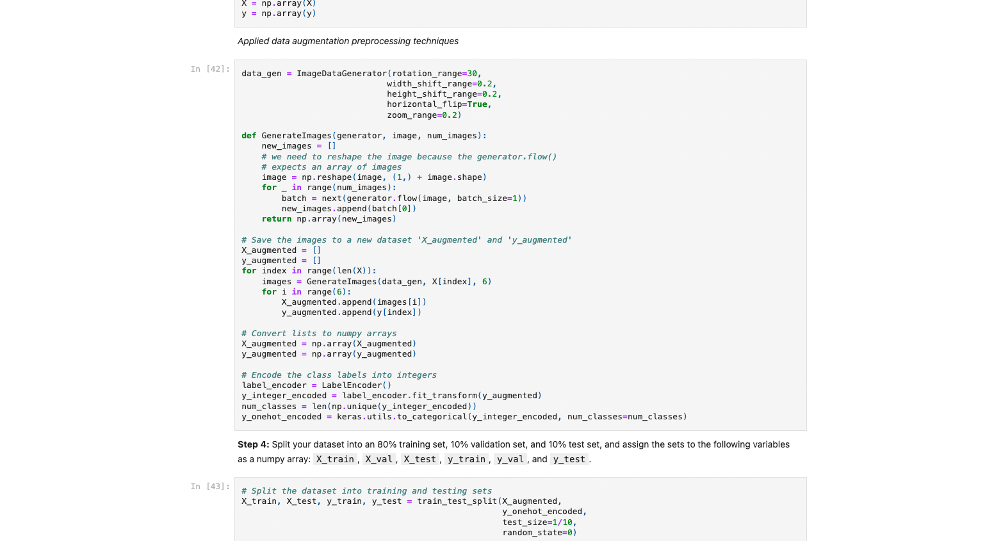
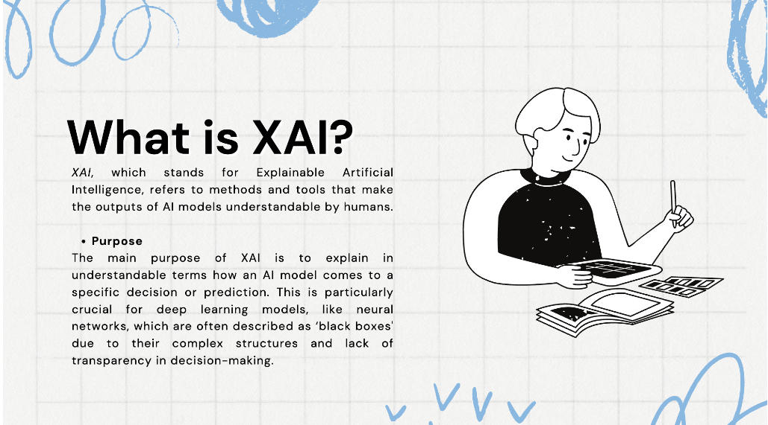
6
Week 6 - Log
3/3
Evidence
https://github.com/BredaUniversityADSAI/2023-24c-fai1-adsai-dariavladutu236578/blob/main/Week 6 - Responsible AI/W6-Integrated-Gradients.ipynb
https://github.com/BredaUniversityADSAI/2023-24c-fai1-adsai-dariavladutu236578/blob/main/Deliverables/CreativeBrief_%3CDariaVladutu%3E_%3C236578%3E.ipynb
https://github.com/BredaUniversityADSAI/2023-24c-fai1-adsai-dariavladutu236578/blob/main/Week 6 - Responsible AI/Explainable AI.pdf

Slide 24
7
Week 7 - Log
1/3
What did you do?
Reflection
How did the week go?
The week was quite stressful as we are approaching the end of the block.
What went well?
The study load this week was fun
What didn’t go so well?
I did not manage to get everything I wanted done
I keep changing my code for the final deliverable notebook to improve it, which wastes time.
What did you learn?
Learned about human centered machine learning.
Learned about how humans process information, and about the extended mind hypothesis.
Learned about design, design thinking, and about divergent and convergent thinking.
Learned about the power of flow in interaction design.
Learned how users interact with an application, and what each visual queue tells them.
Made the first version of a wireframe for the application prototype.
Learned what a think-aloud study is.
What could be added as an Action point looking forward to next week?
Stop reiterating the modelling phase so as to prioritize more tasks.
What goal(s) did you set for this week?
Complete more of the final deliverable notebook
Learn about human-centered AI (HAI)
Learn more about the interface design and how to implement it into my own project
Complete the think-aloud study
Analyse the results of the XAI methods
Analyse the results of the think-aloud study
What have you actually been able to do?
I completed more on my final deliverable notebook, mainly I have concluded all sections of the modelling phase with a short paragraph.
I have analysed more in-depth the results of the error analysis
I learned what HAI is in the context of our project.
I implemented what I learned about interface design into my wireframe.
I completed the think-aloud study.
I have analysed the results of my XAI visualisations.

Slide 25
7
Week 7 - Feedback
2/3
Team, individual, peer, workshop feedback
[Reviewer] Feedback
Response

Slide 26
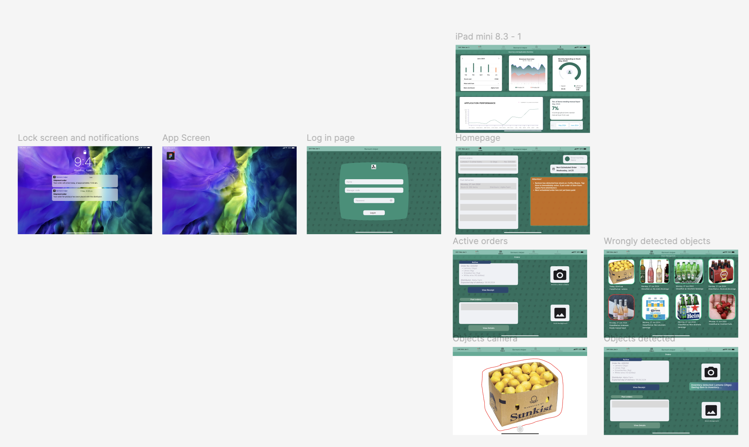
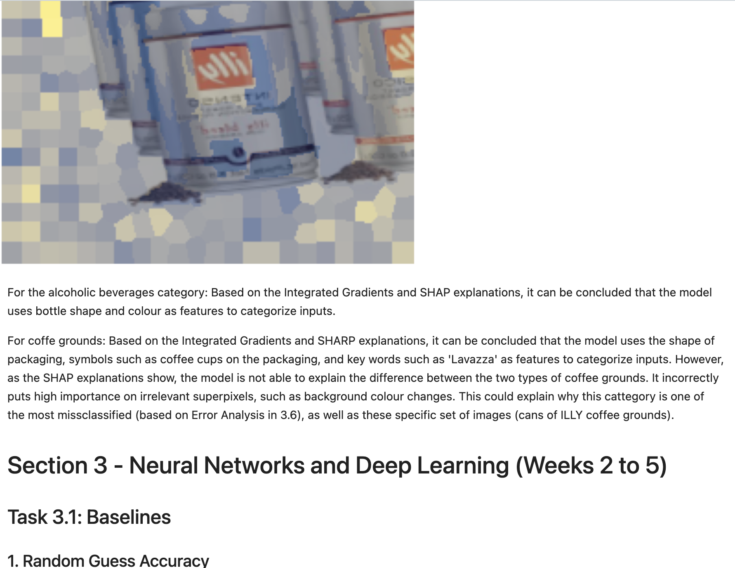
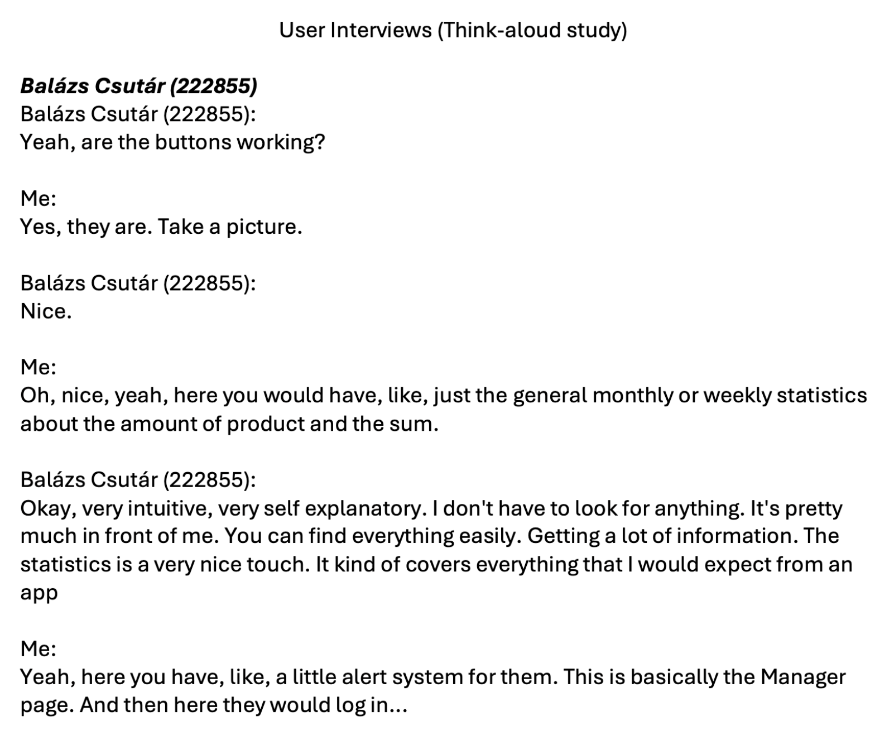
7
Week 7 - Log
3/3
Evidence
https://github.com/BredaUniversityADSAI/2023-24c-fai1-adsai-dariavladutu236578/blob/main/Week%207%20-%20Human%20-%20centered%20AI/Barman's%20helper%20A.pdf
https://github.com/BredaUniversityADSAI/2023-24c-fai1-adsai-dariavladutu236578/blob/main/Deliverables/CreativeBrief_%3CDariaVladutu%3E_%3C236578%3E.ipynb
https://github.com/BredaUniversityADSAI/2023-24c-fai1-adsai-dariavladutu236578/blob/main/Week%207%20-%20Human%20-%20centered%20AI/User%20Transcriptions/User%20Interviews.pdf

Slide 27
8
Week 8 - Log
1/3
What did you do?
Reflection
What goal(s) did you set for this week?
Finish with the final deliverable notebook
Perform t-test
Analyze the results of the think-aloud study in a separate doc, as well as in the final notebook
Implement the feedback into the final wireframe design
Wrap-up final presentation design
Create demo video for the project
What have you actually been able to do?
I have managed to do everything.
How did the week go?
The week was stressful.
What went well?
I managed to get everything done even though at first I thought it would be impossible.
What didn’t go so well?
It was really tiring
I overstepped the maximum presentation time
What did you learn?
Lerned how to implement user feedback into the final version of a wireframe
Learned what users usually look for when it comes to interface design for an app
Completed the MLP from scratch section.
Changed some interpretations of the results of the models' performances and added conclusions to sections.
Completed the Human-Centered AI section of the deliverable.
What could be added as an Action point looking forward to next week?
Think about what went wrong this block and how I can improve next block.

Slide 28
8
Week 8 - Feedback
2/3
Team, individual, peer, workshop feedback
[Reviewer] Feedback
Response

Slide 29
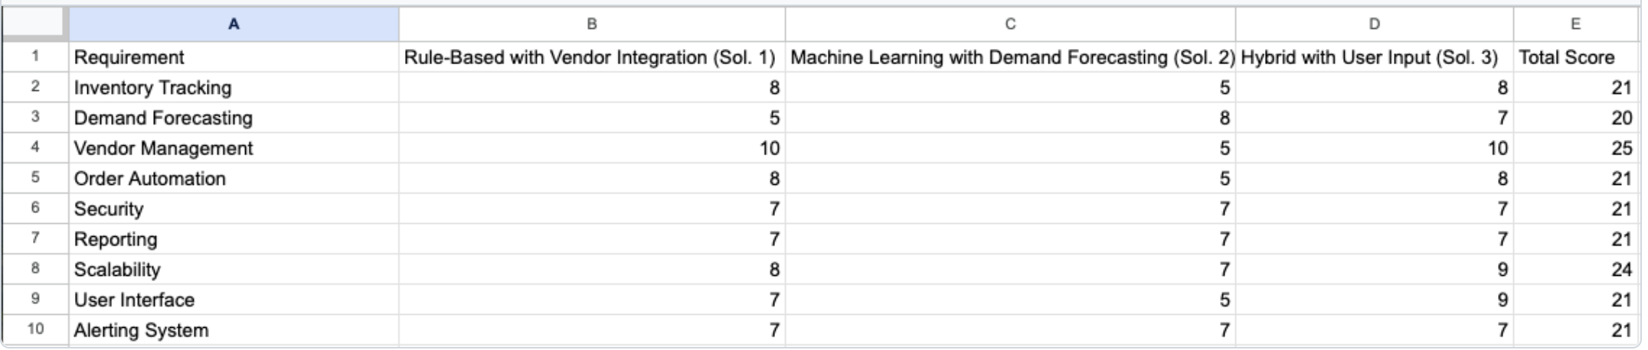
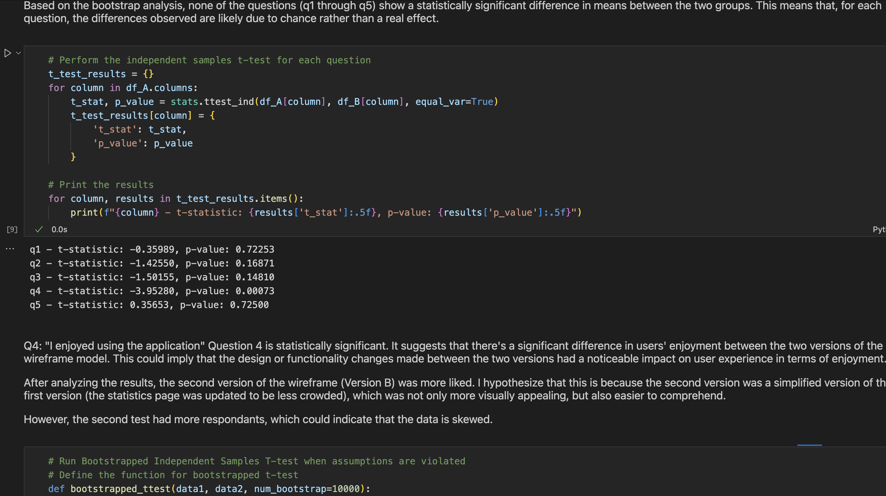
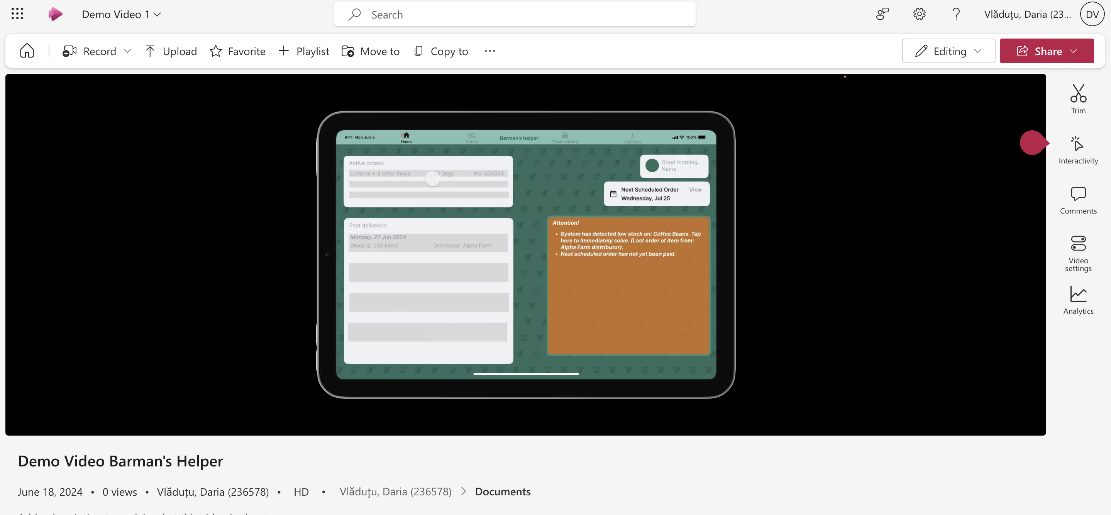
8
Week 8 - Log
2/3
Evidence
https://github.com/BredaUniversityADSAI/2023-24c-fai1-adsai-dariavladutu236578/blob/main/Week%207%20-%20Human%20-%20centered%20AI/Screenshot%202024-04-05%20at%2001.43.07.png
https://edubuas-my.sharepoint.com/personal/236578_buas_nl/_layouts/15/stream.aspx?id=%2Fpersonal%2F236578%5Fbuas%5Fnl%2FDocuments%2FDemo%20Video%201%2Emp4&referrer=StreamWebApp%2EWeb&referrerScenario=AddressBarCopied%2Eview%2E82958758%2D833c%2D452c%2D91f7
https://github.com/BredaUniversityADSAI/2023-24c-fai1-adsai-dariavladutu236578/blob/main/Week%208%20-%20Prototype%20-%20Human-Centered%20AI/T-testIndependentSamplesHCAI%20.ipynb

Slide 30
Section C
C
Progress
Intended Learning Outcomes
Notes:
MUST BE COMPLETED IN WEEK 8, BUT SHOULD BE UPDATED REGULARLY
This is where you link your evidence to each of the Intended Learning Outcomes of this block.

Slide 31
ILO 1
1
Professional Practice
The student demonstrates professional behavior as well as accountability and ethics in the application of industry best practices for planning, communication, collaboration, and responsible execution of work assignments.

Slide 32
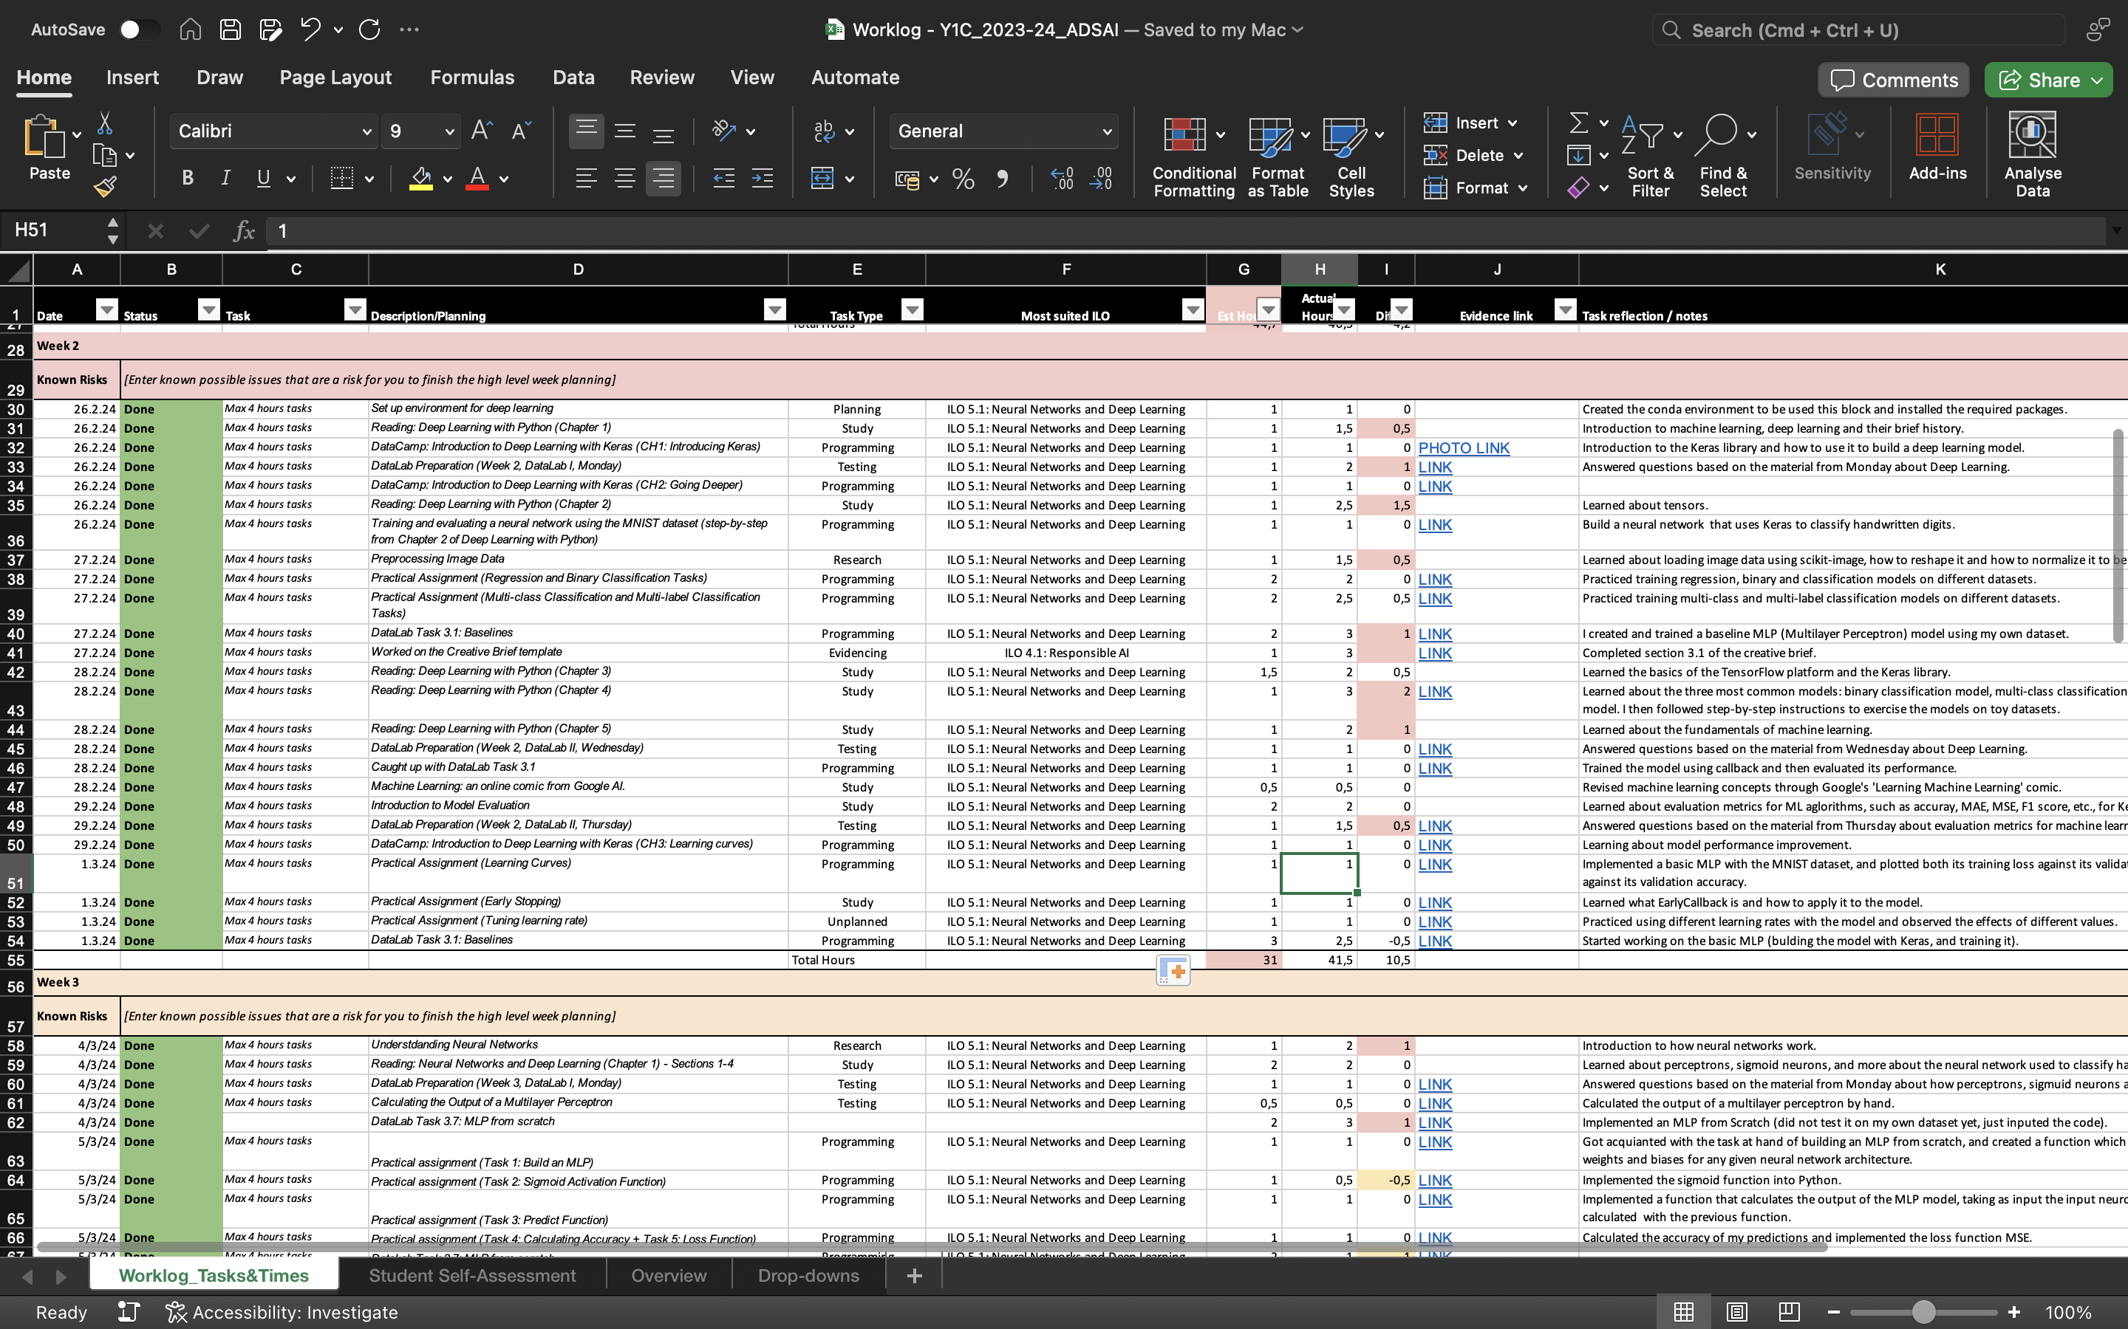
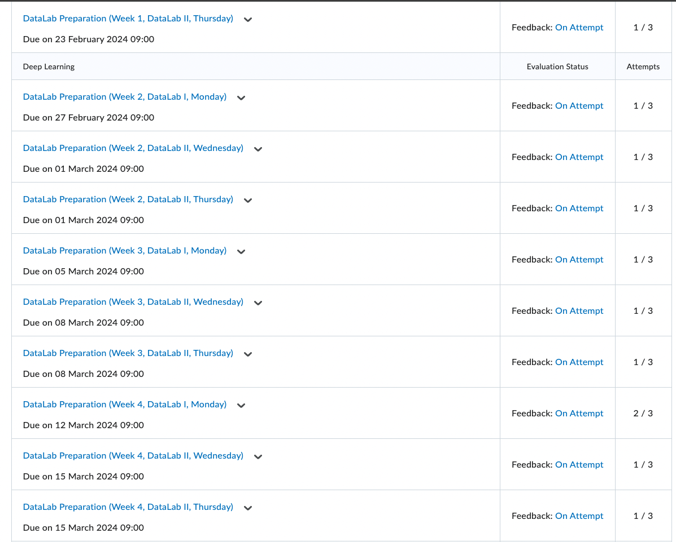
ILO 1
Professional Practice
The student demonstrates professional behavior as well as accountability and ethics in the application of industry best practices for planning, communication, collaboration, and responsible execution of work assignments.
1/6
1.3
The student attends the Datalab sessions, and submits work, adhering to defined guidelines and processes in the Creative Brief.
Poor: I have notified the teaching staff about all of my absences and even contacted the student council regarding a personal family issue that affected my attendance for almost 2 weeks.
Insufficient: I have prepared most DataLab Preparations on time and completely. I have updated my Work Log regularly and made sure to give detailed descriptions of the tasks, as well as provided evidence for my work where possible.
Sufficient: I have updated my work log on a regular basis.
Good: I have made sure that my work adheres to professional standards regarding grammar, spelling, writing style, content, and neatness.
IMPORTANT INFORMATION: The DataLab Preparations which have 2 submissions do so because I wanted to change the answers as I have used the preparations as a note-taking system. The first submission has always been on time. I urge you to consider the first submission for grading.
LINK TO WORK LOG: https://github.com/BredaUniversityADSAI/2023-24c-fai1-adsai-dariavladutu236578/blob/main/Deliverables/Worklog - Y1C_2023-24_ADSAI.xlsx

Slide 33
ILO 2
2
Personal Development
& Academic Practice
The student demonstrates self-exploration and personal development, good academic practices in learning how to learn and the acquisition of professional knowledge through research, study, analysis, applied practice, discussion and reporting, where an excellent performance would show.

Slide 34
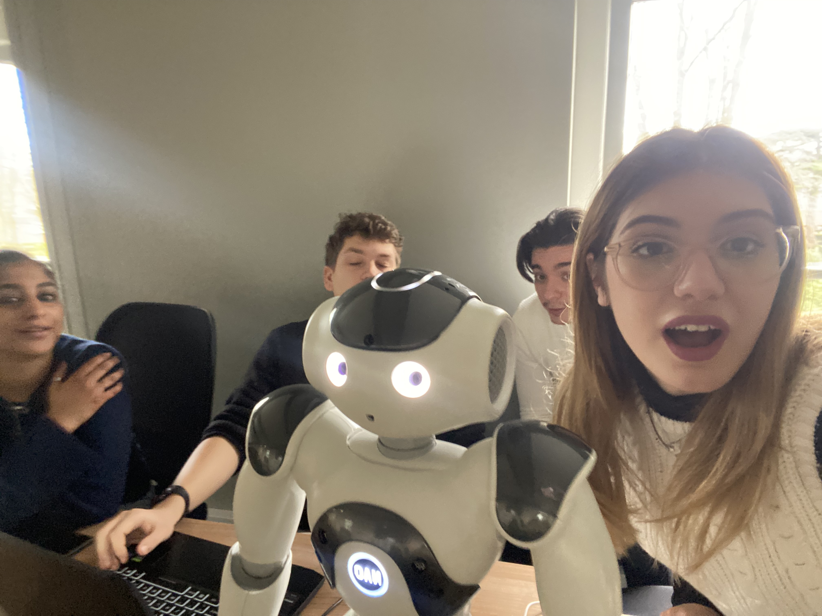
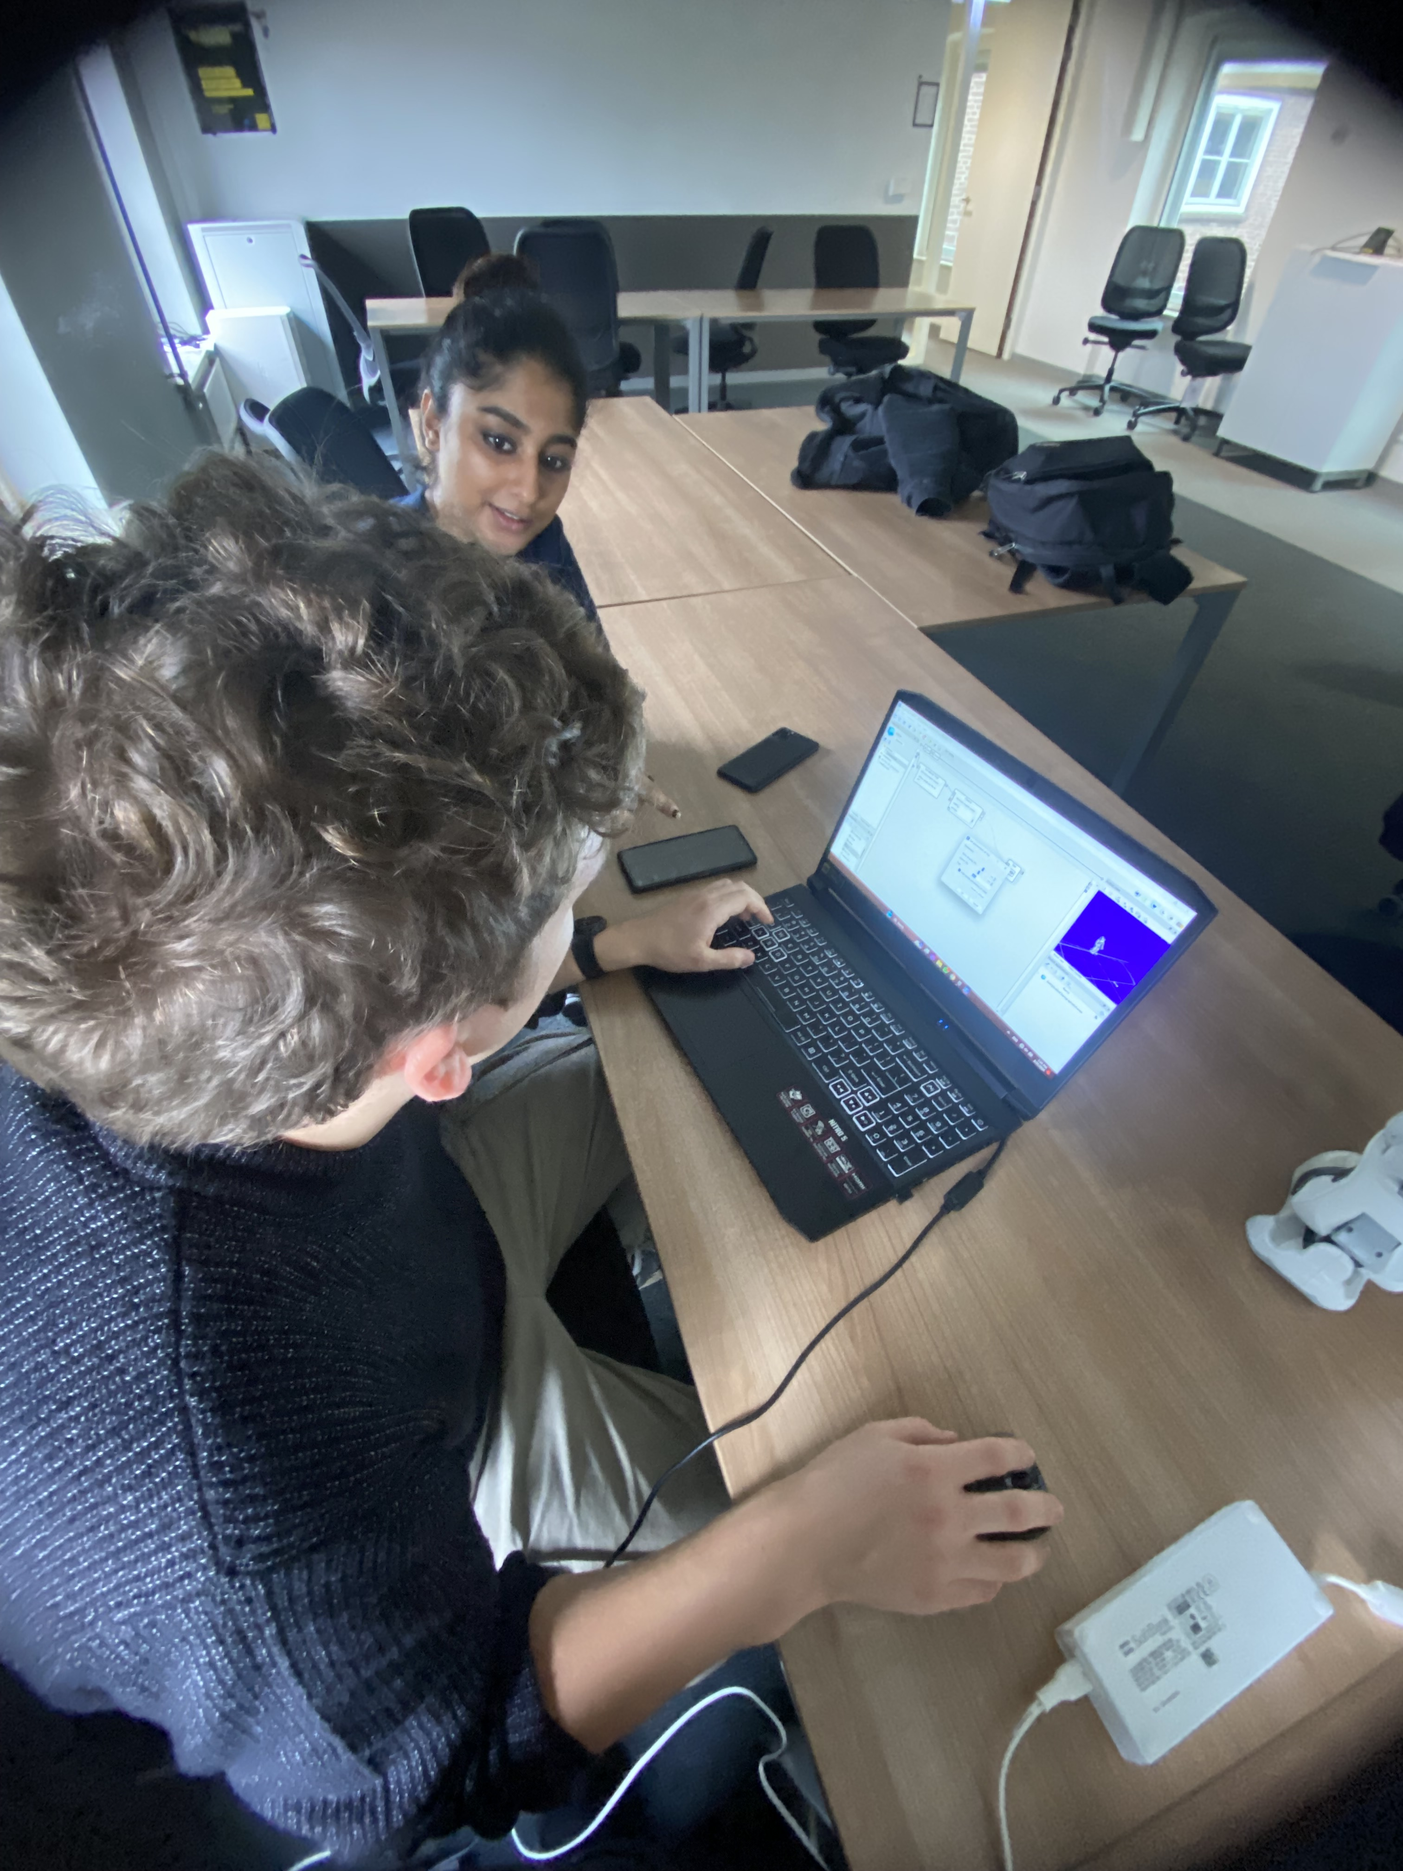
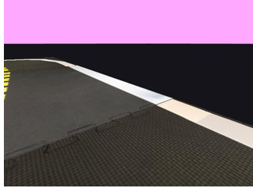
ILO 2
Personal Development & Academic Practice
The student demonstrates self-exploration and personal development, good academic practices in learning how to learn and the acquisition of professional knowledge through research, study, analysis, applied practice, discussion and reporting, where an excellent performance would show.
2/6
2.2
The student regularly engages in self-guided study and self-development, including active engagement in professional learning communities, studying online resources and active participation in (online) communities.
Poor: I have participated in the week 9-10 Kaggle challenge.
Insufficient: I have completed, along with my team and to the best of our abilities, the Kaggle challenge.
Sufficient: The second challenge I have participated in is the Nao & Pepper challenge.
Good: I have enrolled in the third challenge (Nao & Pepper). Evidence will be provided after the challenge is finished.
Links to evidence:
DuckieTown –https://github.com/BredaUniversityADSAI/2023-24c-fai1-adsai-dariavladutu236578/blob/main/Week 9-10 challenges/Duckietown_challenges.ipynb
Nao and Pepper 1 – https://github.com/BredaUniversityADSAI/2023-24c-fai1-adsai-dariavladutu236578/tree/main/Week 9-10 challenges/NAO and Pepper 1
Nao and Pepper 2 –
https://github.com/BredaUniversityADSAI/2023-24c-fai1-adsai-dariavladutu236578/tree/main/Week 9-10 challenges/Albert Heijn NAO (NAO and Pepper 2)

Slide 35
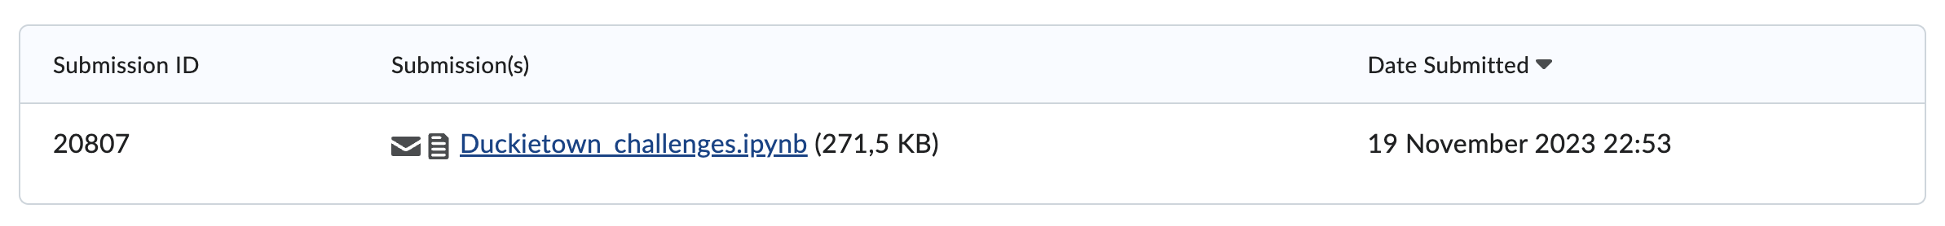
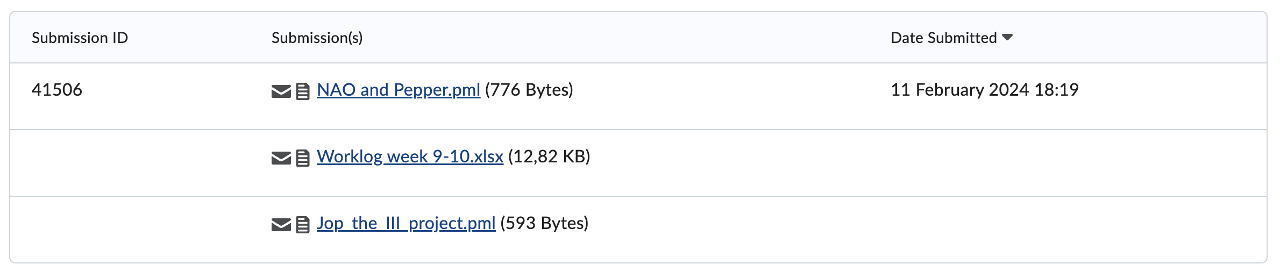
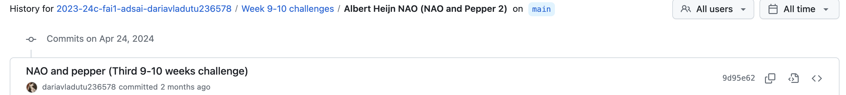
ILO 2
Personal Development & Academic Practice
The student demonstrates self-exploration and personal development, good academic practices in learning how to learn and the acquisition of professional knowledge through research, study, analysis, applied practice, discussion and reporting, where an excellent performance would show.
2/6
2.2
The student regularly engages in self-guided study and self-development, including active engagement in professional learning communities, studying online resources and active participation in (online) communities.
Poor: I have participated in the week 9-10 Kaggle challenge.
Insufficient: I have completed, along with my team and to the best of our abilities, the Kaggle challenge.
Sufficient: The second challenge I have participated in is the Nao & Pepper challenge.
Good: I have enrolled in the third challenge (Nao & Pepper). Evidence will be provided after the challenge is finished.
Evidence of submission on time:
As the feedback provided after the first submission states that the third 9-10 weeks challenges were not uploaded before the deadline, here is the evidence for the submission (the deadline was 24th of April):

Slide 36
ILO 3
3
Business Understanding
The student is able to generate an idea for an application and identifies a target market in need of this product as well as evaluate this idea based on potential disruptive technology risks and the AI canvas.

Slide 37
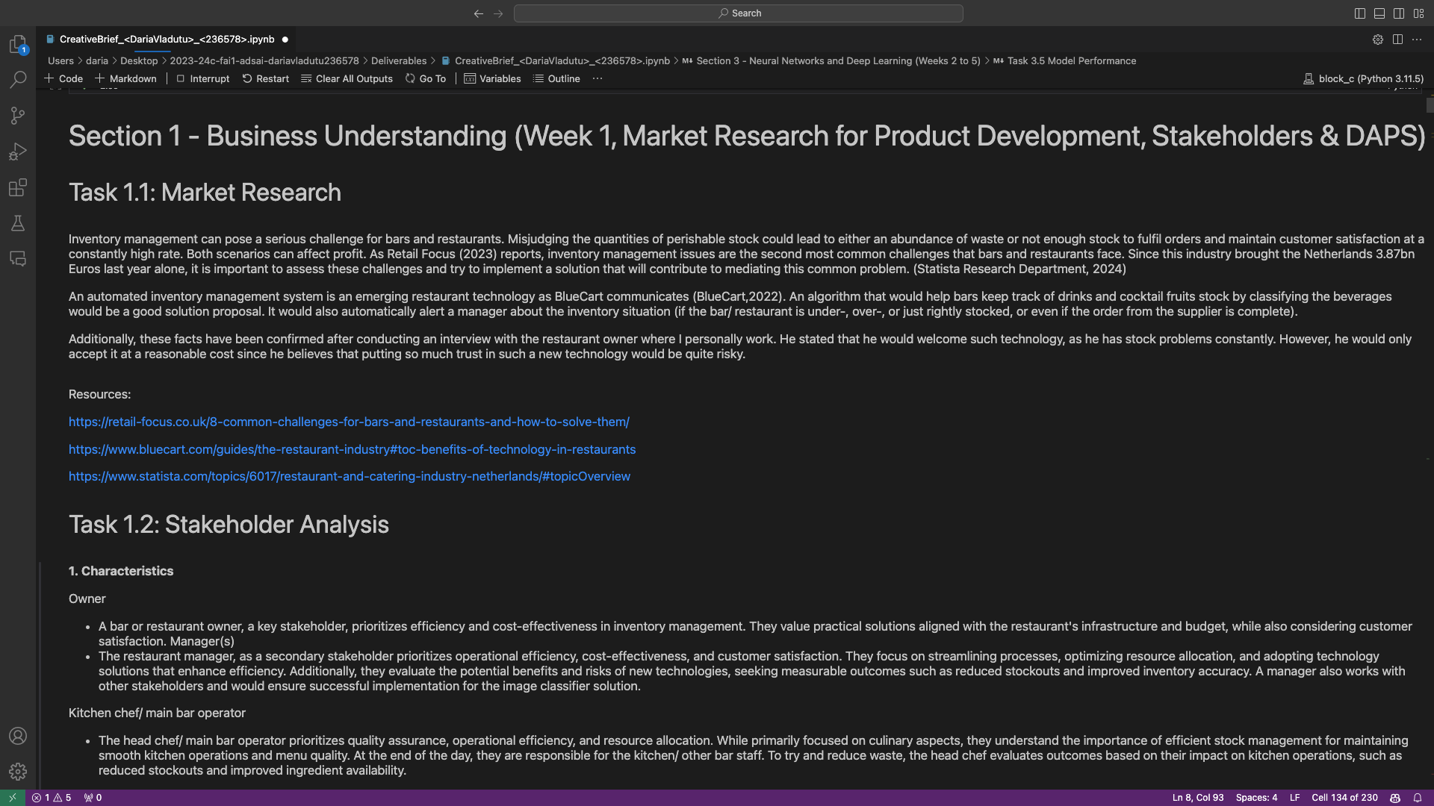
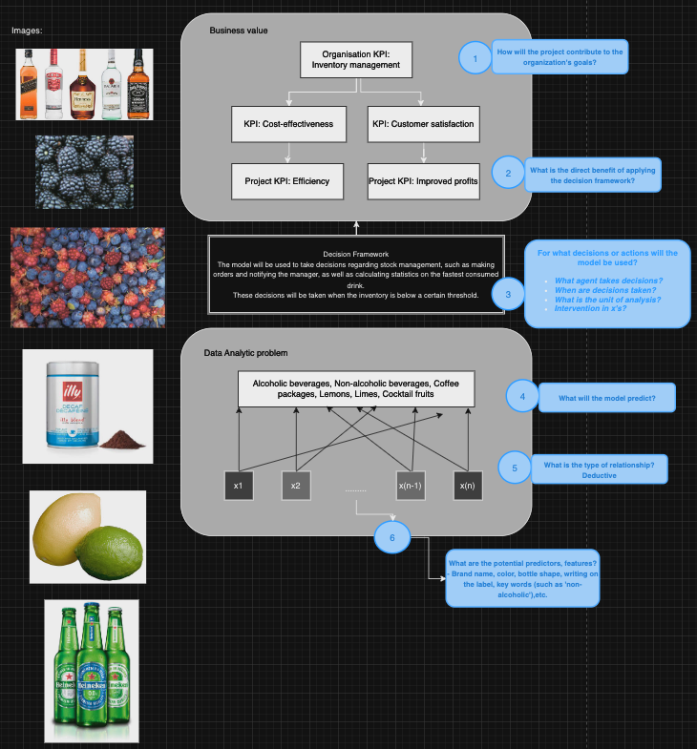
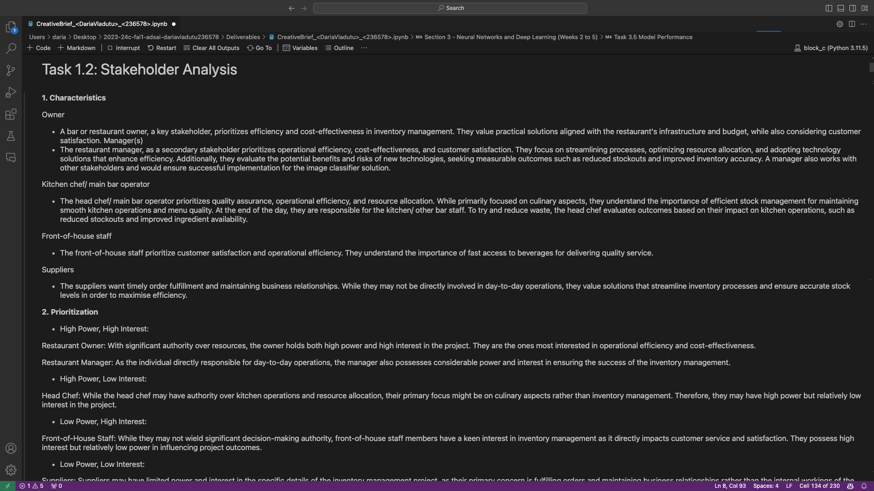
ILO 3
Business Understanding
The student is able to identify a data-analytics problem using DAPS diagram and creates an idea for an AI application that solves the problem and delivers value to an organization or industry.
3/6
3.1
The student is able to identify a data-analytics problem using DAPS diagram and creates an idea for an AI application that solves the problem and delivers value to an organization or industry.
Poor: I have conducted research into the restaurant industry by using online resources, as well as interviewing with the owner of the facility where I personally work. I have identified the problem of efficient stock management.
Insufficient: I have conducted a stockholder analysis using the Power and Interest grid matrix, and identified the main stockholders. I have described each stockholder in detail also based on their individual roles.
Sufficient: I have realized a DAPS diagram using the previous knowledge and I have showcased details about the features of the model and its classes, the decision framework, and what value my idea brings to the industry.
Good: I have created an application that aligns with the data analytics problem by attempting to solve one of the most common problems in the HoReCa industry.
Excellent: The application idea delivers value to the HoReCa industry.
Link to the DAPS diagram:
https://github.com/BredaUniversityADSAI/2023-24c-fai1-adsai-dariavladutu236578/blob/main/Week%201%20-%20Responsible%20AI/DAPS%20DIAGRAM.png
Evidence for the rest of the criteria:
https://github.com/BredaUniversityADSAI/2023-24c-fai1-adsai-dariavladutu236578/blob/main/Deliverables/CreativeBrief_%3CDariaVladutu%3E_%3C236578%3E.ipynb

Slide 38
ILO 4
4
Responsible AI
The student is able to identify and describe the limitations of a deep learning-based AI algorithm in terms of bias, fairness, transparency, and interpretability, and subsequently apply methods that address these limitations.

Slide 39
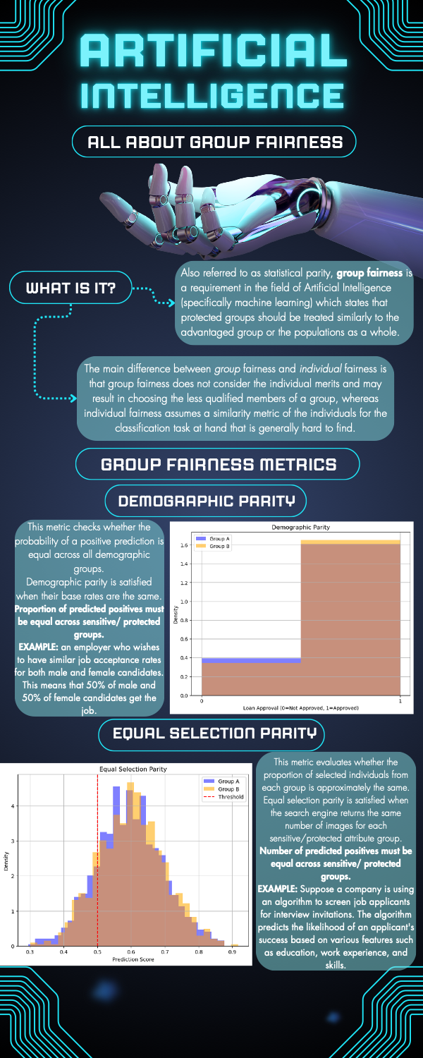
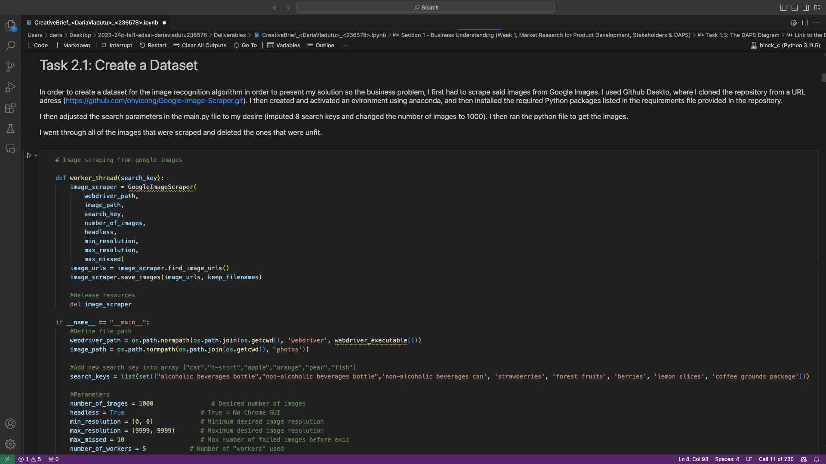
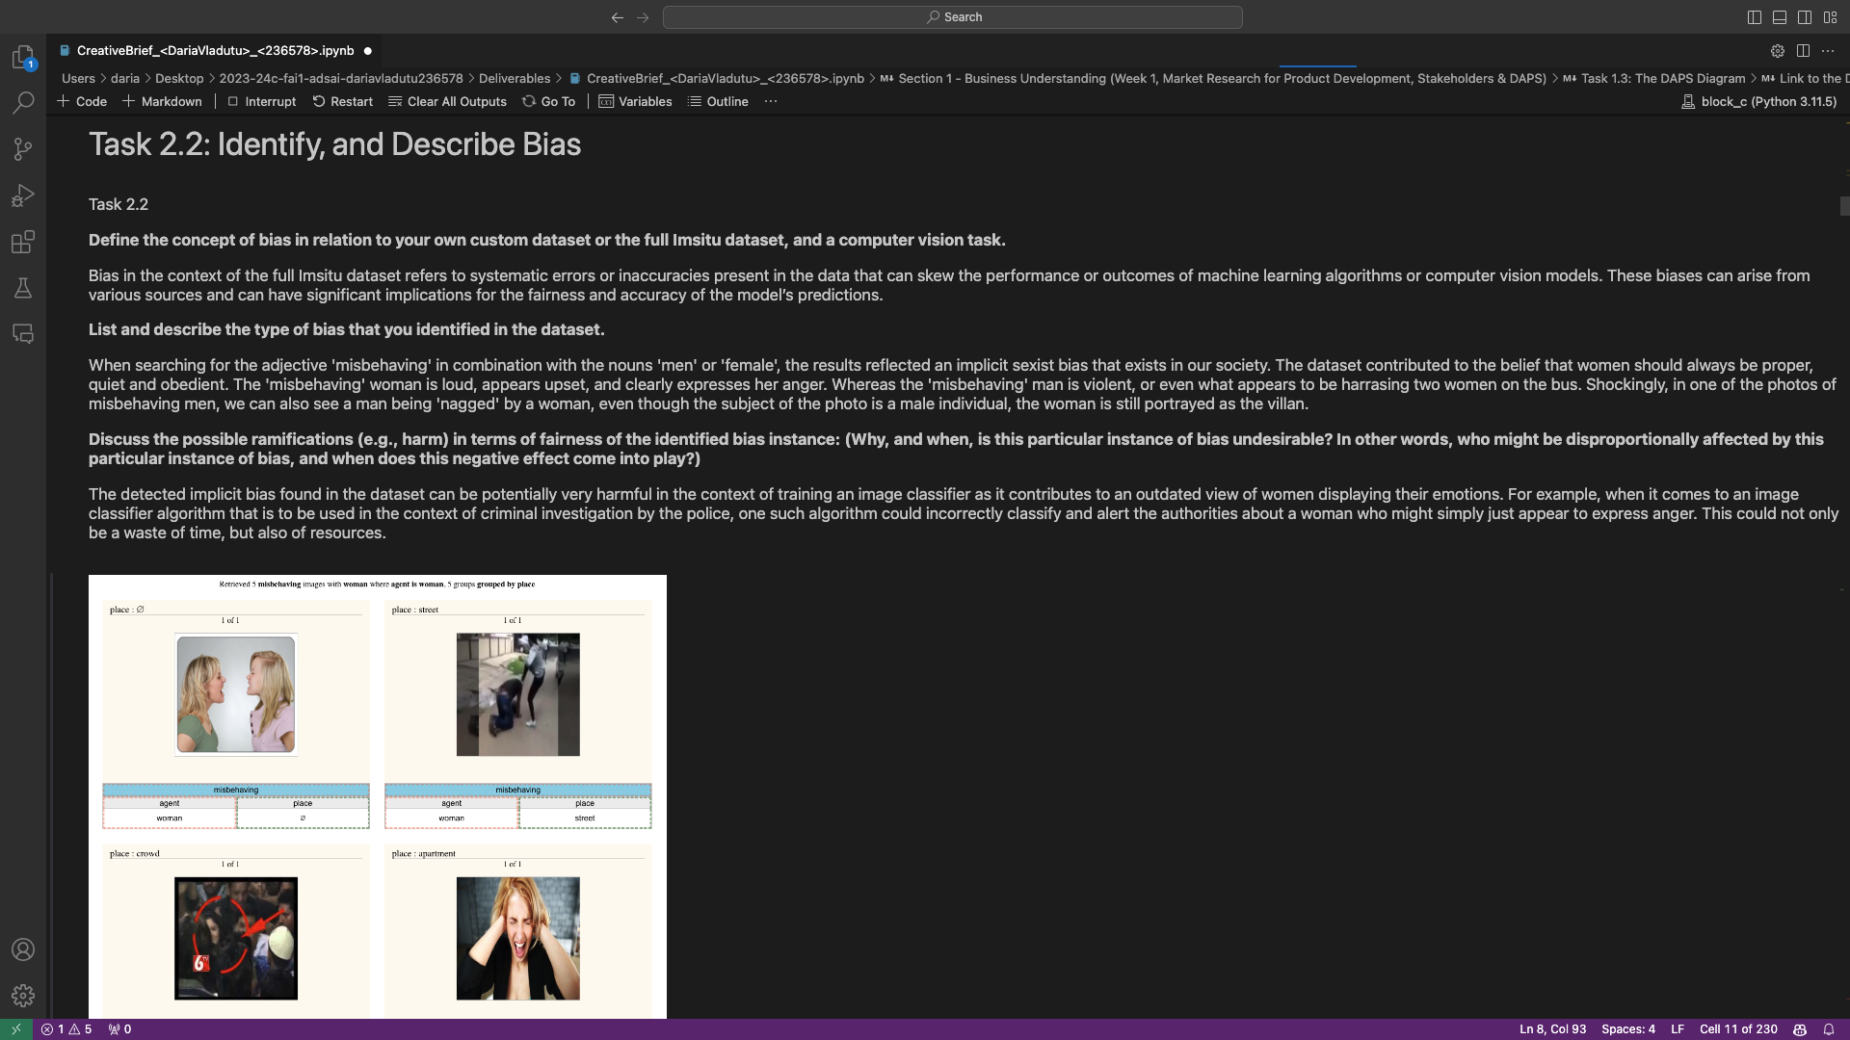
ILO 4
Responsible AI
The student is able to identify and describe the limitations of a deep learning-based AI algorithm in terms of bias, fairness, transparency, and interpretability, and subsequently apply methods that address these limitations.
4/6
4.1
The student is able to identify and describe the limitations of a deep learning-based AI algorithm in terms of bias, fairness, transparency, and interpretability, and subsequently apply methods that address these limitations.
Poor: I have created my own dataset by scraping the web for colour images.
Insufficient: I have identified and described an instance of bias (gender stereotypes) in the Imsitu dataset. I have discussed the possible implications of this bias and proposed a suitable individual fairness method (Fairness Through Awareness). I have properly explained how this approach addresses the dataset’s limitations in terms of bias and fairness.
Sufficient: I have realized an infographic that visually explains the concept of group fairness and its evaluation metrics. I have implemented an explainable AI method (Integrated Gradients) that addressed the deep learning algorithm’s limitations in terms of transparency and interpretability
Good: I have implemented two XAI methods (Integrated Gradients) that address the model’s limitations in terms of interpretability and transparency. I have evaluated the trade-off between accuracy and interpretability, identified key patterns that my model detects, and exemplified with illustrations its identified object, textures, and shapes in the images.
Link to the infographic:
https://github.com/BredaUniversityADSAI/2023-24c-fai1-adsai-dariavladutu236578/blob/main/Week%201%20-%20Responsible%20AI/Group%20Fairness%20Infographic%20Modified.pdf
Link to the rest of the evidence:
https://github.com/BredaUniversityADSAI/2023-24c-fai1-adsai-dariavladutu236578/blob/main/Deliverables/CreativeBrief_%3CDariaVladutu%3E_%3C236578%3E.ipynb

Slide 40
ILO 5
5
Neural Networks and Deep Learning
The student is able to explain different types of feed-forward artificial neural network (ANN) architectures for supervised learning and can design and implement them for an image classification problem.

Slide 41
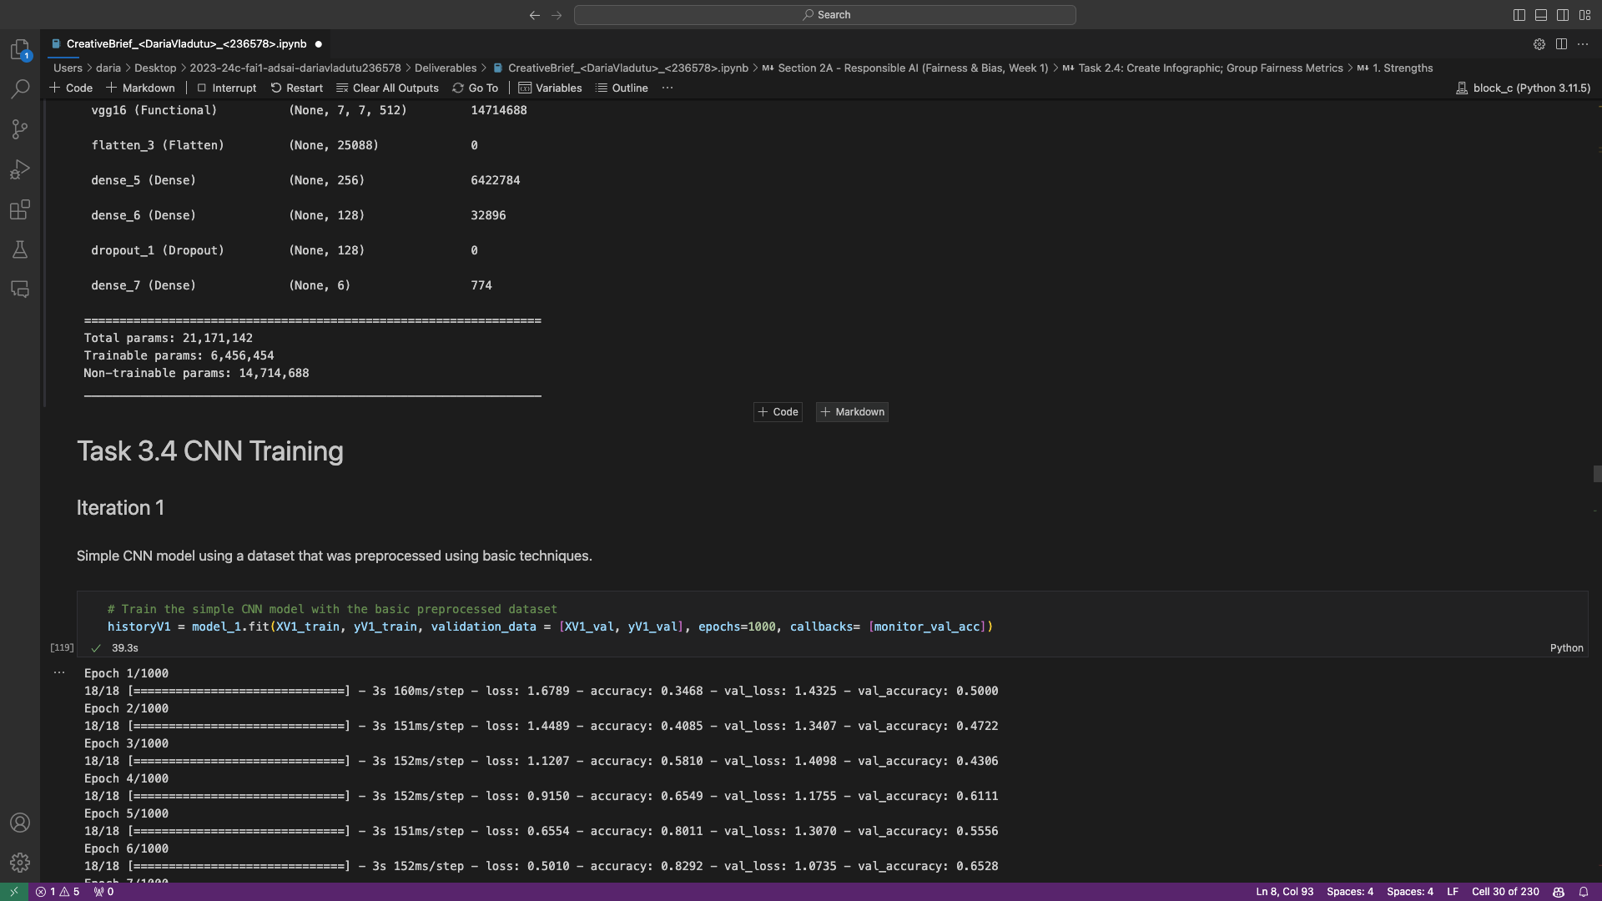
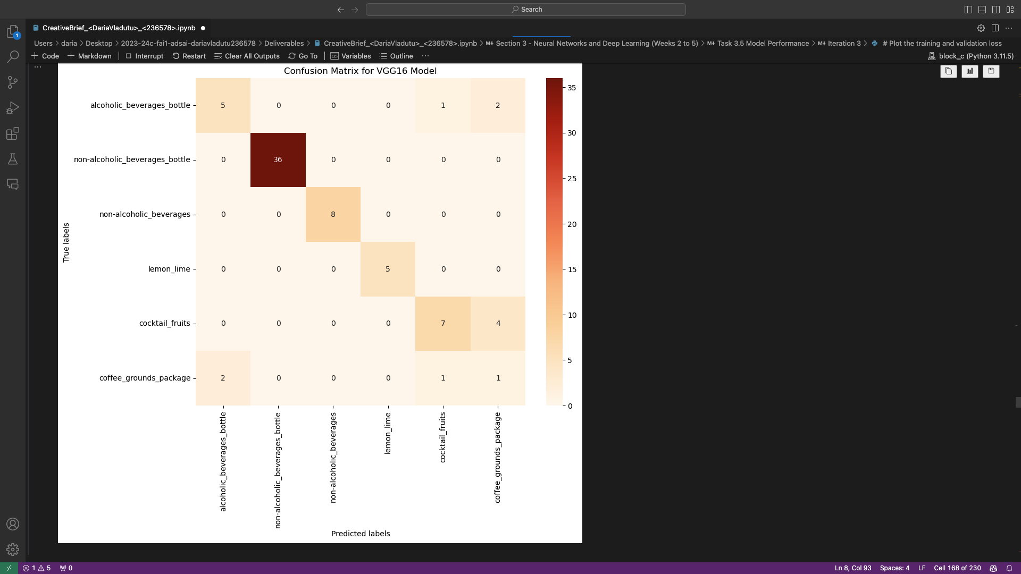
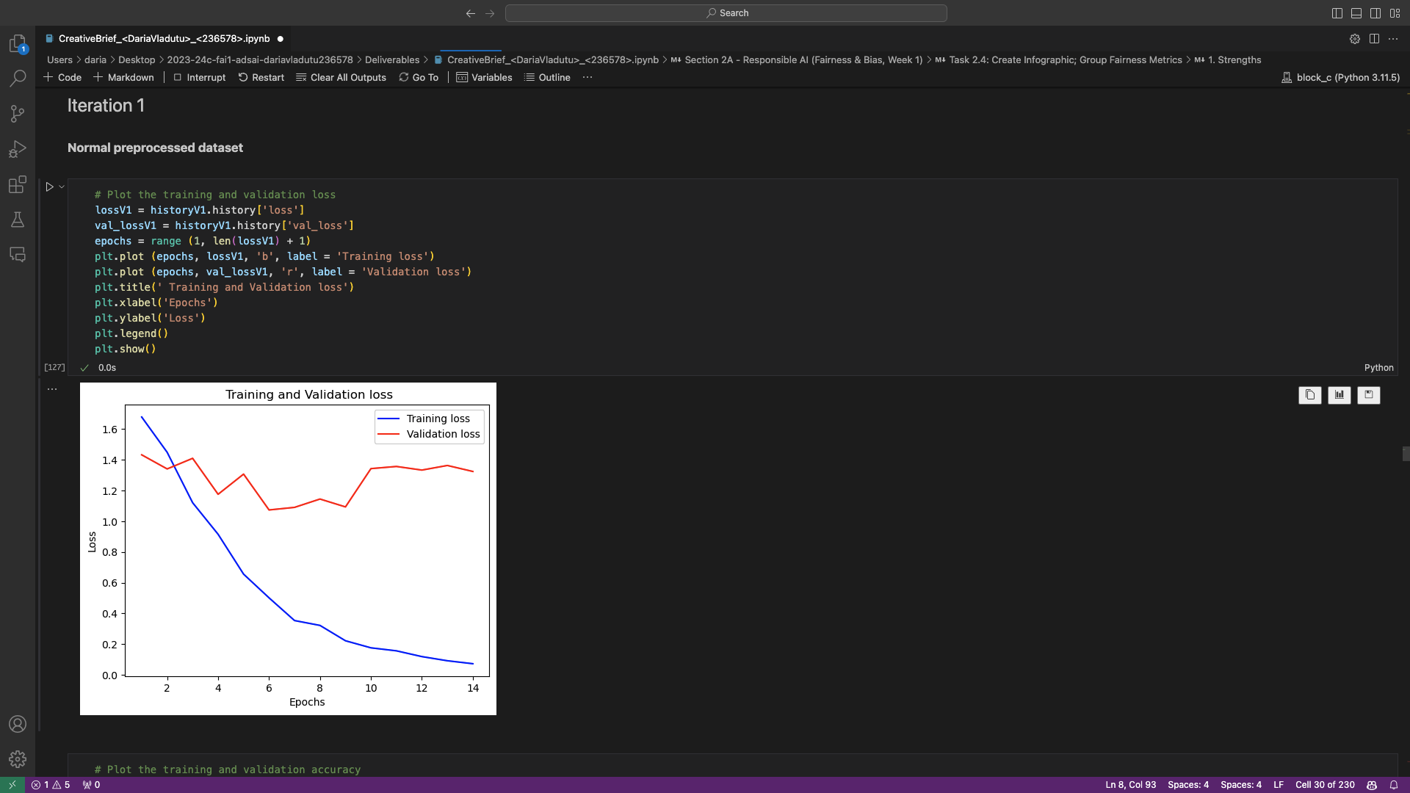
ILO 5
Neural Networks and Deep Learning
The student is able to explain different types of feed-forward artificial neural network (ANN) architectures for supervised learning and can design and implement them for an image classification problem.
5/6
5.1
The student is able to explain different types of feed-forward artificial neural network (ANN) architectures for supervised learning and can design and implement them in an image classification problem.
Poor: I have established baseline for my image classification problem by calculating random guess accuracy, basic MLP (Multilayer Perceptron) accuracy, and HLP (Human-Level Performance) accuracy.
Insufficient: I have designed and successfully implemented a CNN using Keras for image classification.
Sufficient: I have applied data augmentation and used transfer learning. I have performed error analysis for the models used.
Good: I have implemented four iterations with proper reasoning, demonstrating my ability to understand the iterative nature of the MLPL (Machine Learning Project Lifecycle).
Excellent: I constructed an MLP from scratch without using any external libraries such as Keras or TensorFlow.
Evidence for all of the mentioned criteria:
https://github.com/BredaUniversityADSAI/2023-24c-fai1-adsai-dariavladutu236578/blob/main/Deliverables/CreativeBrief_%3CDariaVladutu%3E_%3C236578%3E.ipynb

Slide 42
ILO 6
6
Human-Centered AI
The student is able to design and develop a prototype of an application which embeds their own analyses and algorithms.

Slide 43
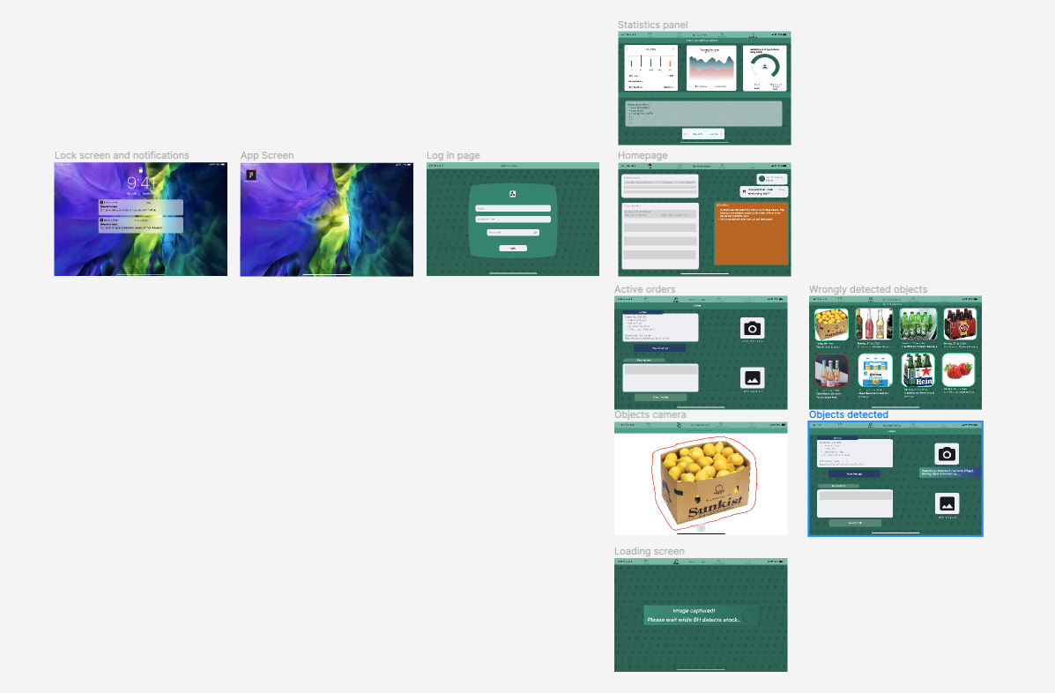
ILO 6
Human-Centered AI
The student is able to design and develop a prototype of an application which embeds their own analyses and algorithms.
6/6
6.1
The student is able to develop a wireframe prototype for an application embedding a novel algorithm using various design techniques, explicitly involving stakeholders in the process.
Poor: I developed a working wireframe prototype which embeds my image classification model into its potential use. The prototype can be opened and tested in the editor of Figma. The application of the wireframe is showcased in a demo video.
Insufficient: I have conducted the think-aloud study and subsequently recorded client feedbacks, to guide and test the design of the wireframe prototype.
Sufficient: I have conducted user testing and delivered the created wireframe prototype alongside an interactive and understandable demo video to the client.
Good: I have incorporated the results of the study in the UX design. The prototype demonstrates a compelling user experience to the client
Link to the wireframe: https://www.figma.com/proto/3aprthR9OARJt1aRxerLAs/Barman's-helper-FINAL-WIREFRAME?type=design&node-id=5-58&t=U7GfWdKV0iEz5F4l-1&scaling=scale-down&page-id=0%3A1&starting-point-node-id=9%3A10129&show-proto-sidebar=1&mode=design
Link to demo video: https://edubuas-my.sharepoint.com/:v:/g/personal/236578_buas_nl/EcYTQt9cpN9Hq10ubsP-sSwBIXsndYW1OUlHJ6BdK7Sz9w?e=odtkND
Link to user testing (A/B testing): https://forms.office.com/e/rbK4j5AZqC
https://forms.office.com/e/jVR7Zd5Rb1
Link to the transcripts of the user testing: https://github.com/BredaUniversityADSAI/2023-24c-fai1-adsai-dariavladutu236578/blob/main/Week 7 - Human - centered AI/User Transcriptions/User Interviews.pdf
Link to evidence of wireframe changes post-user interviews can be found in the final deliverable notebook (Section 4): https://github.com/BredaUniversityADSAI/2023-24c-fai1-adsai-dariavladutu236578/blob/main/Deliverables/CreativeBrief_<DariaVladutu>_<236578>.ipynb

Slide 44
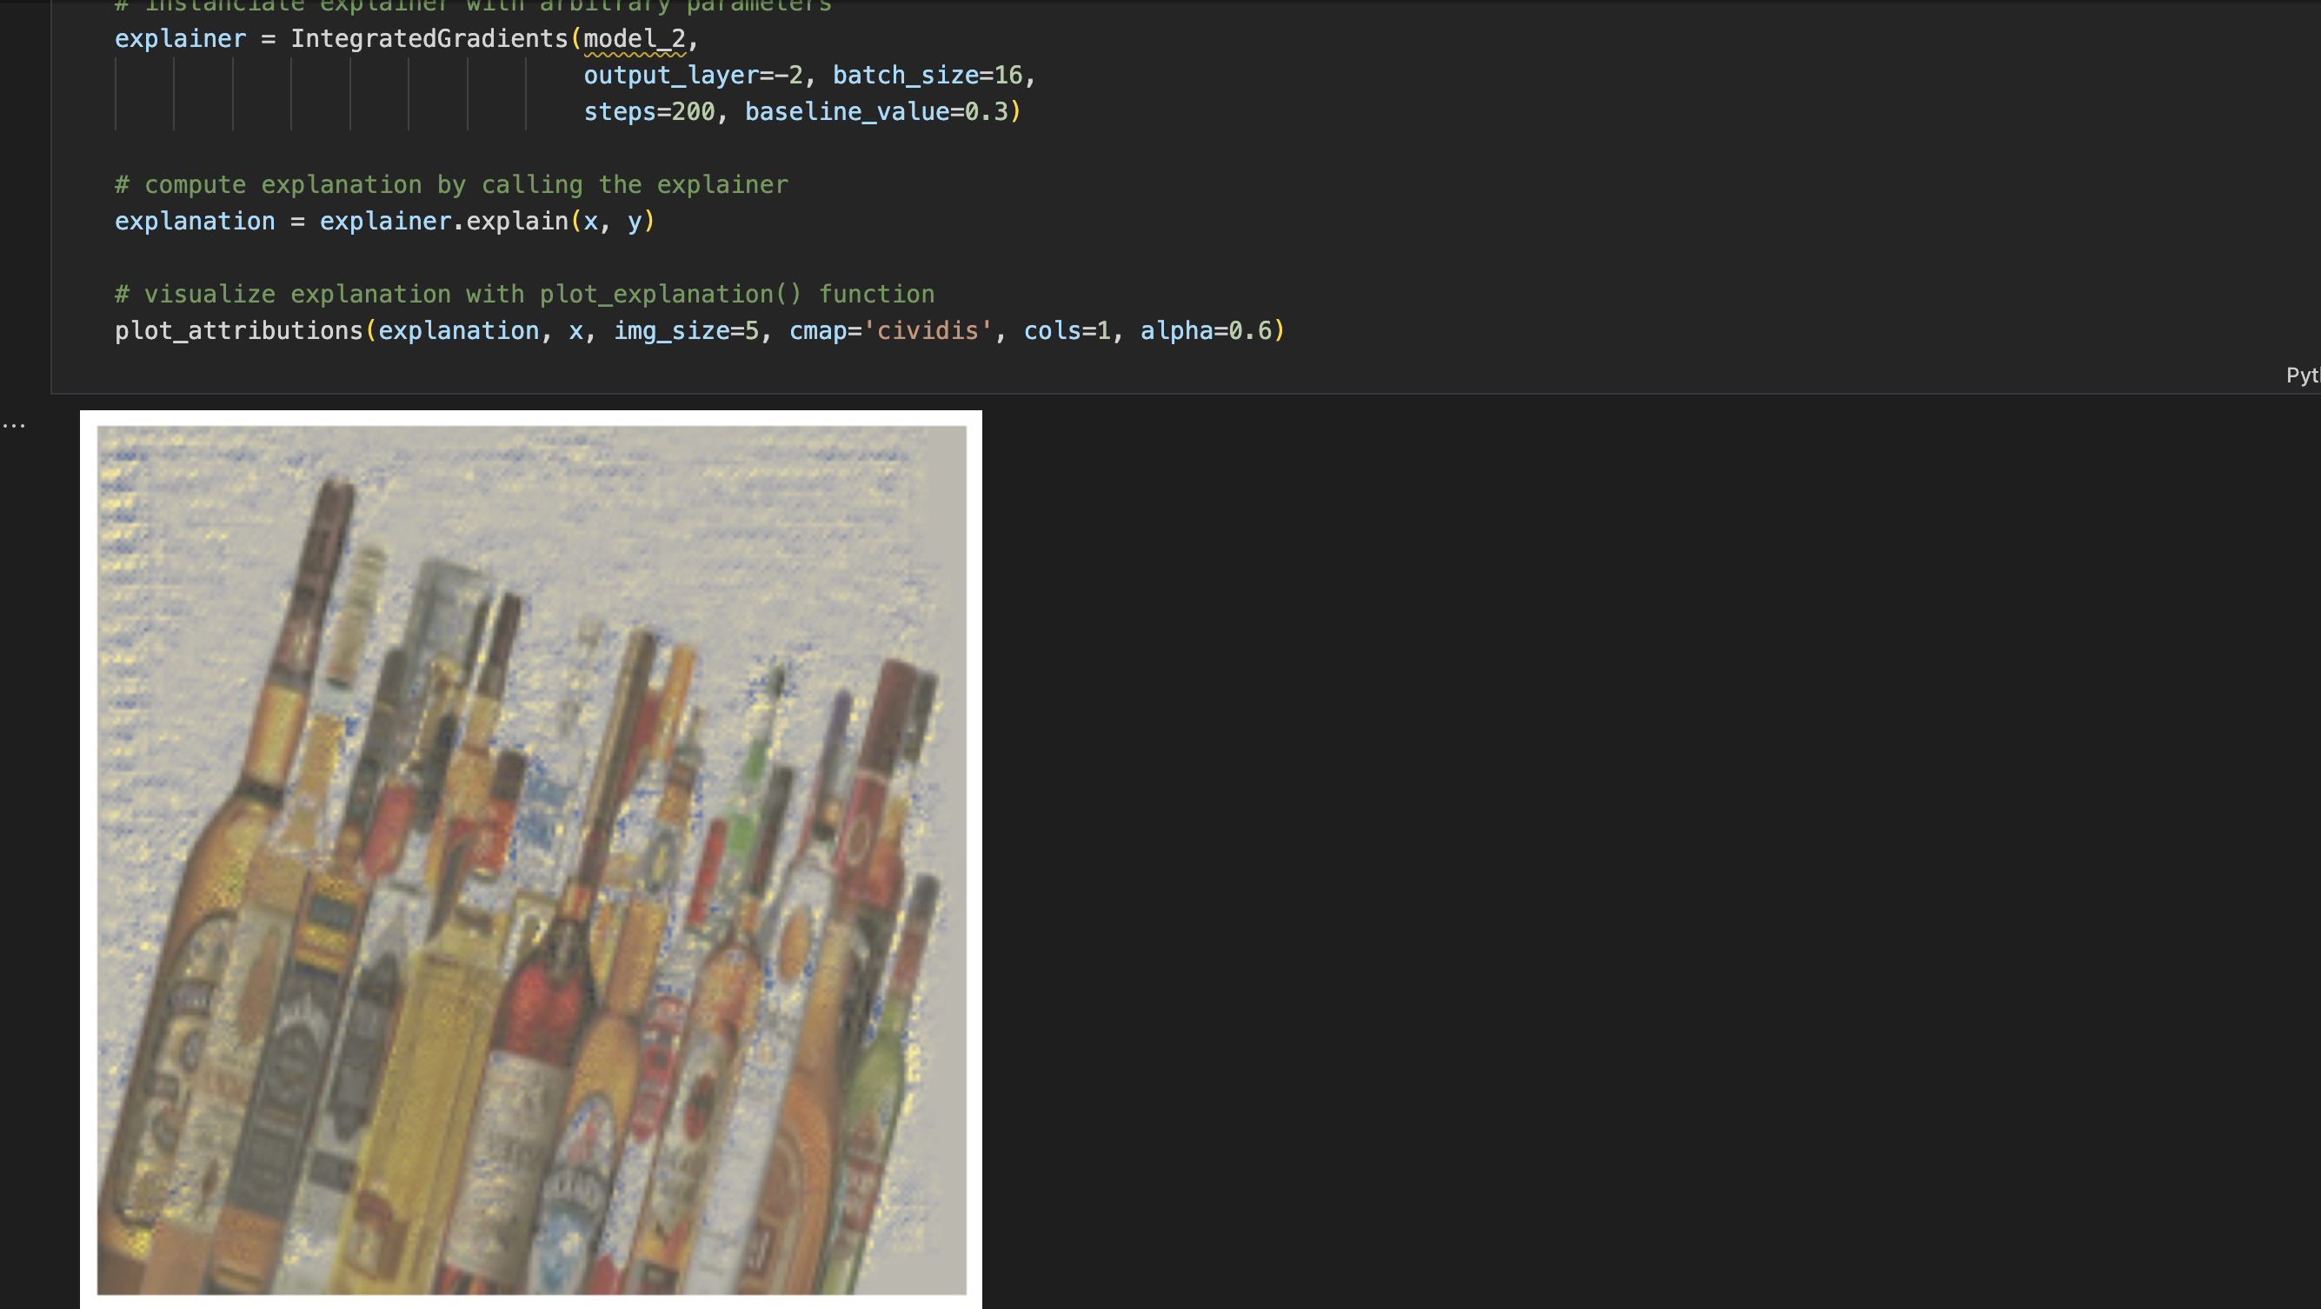
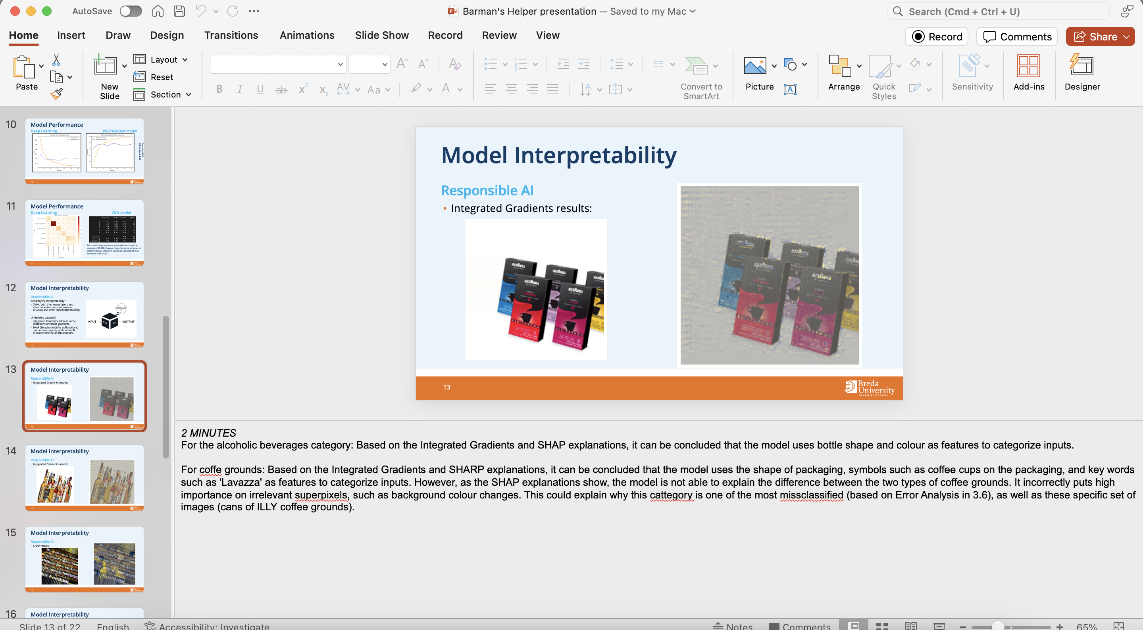
RETAKE
Changes made regarding the second opportunity
General changes:
I have highlited in bright yellow all the changes made to both my Learning Log and my Work Log.
I have modified part of Section B (Progress Log) and provided more detailed explanation of the tasks at hand, as well as multiple links for evidencing my work.
I have submitted the correct version of the work log (the other version was not completed)
I have modified the ‘Model Interpretability’ section of my presentation
I have conducted the think-aloud study.
I performed a T-test on the results of the surveys of my wireframe prototype.
Final deliverable notebook:
I have modified Task 1.4 to better explain the value delivered by my application. (regarding ILO 3.1)
I have implemented two XAI methods (Integrated Gradients and SHAP), which I used to explain my model’s limitations in terms of transparency, and evaluated the trade-off between accuracy and interpretability
I explained the changes made towards the final wireframe prototype.

Slide 45

Medal Challenges
Going the extra mile!

Slide 46
Medal Challenges
Going the extra mile!
1/1
Put your evidence down here to receive a medal!
Show your best examples, do not go overboard, add in short description, you are free to alter this layout (or add slides per evidence) to suit your needs. Just be sure that it is clear.

Slide 47
Section D
D
Reflection
Notes:
MUST BE COMPLETED IN WEEK 8
Summative reflection on your progress during the block including a critical assessment of everything you did and learned during the block. This is a comprehensive review of everything recorded in Section B.

Slide 48
D
What did I achieve this block?
1/2
My most significant achievements this block
I believe my most significant achievement this block was understanding and implementing my own CNN model on my own personal dataset.
My most difficult challenges this block
The most significant challenge for me this block was grasping the way neural networks function, from the architecture of a model, to training it to a certain dataset.
The most important lessons I learned
I am now more confident that this field of work really interests me and that I could improve with enough discipline.

Slide 49
D
How well am I progressing?
2/2
Reflection on my self assessment
My self assessment grade is a
8.5
I believe the self assessment does reflect the level of knowledge accumulated during this block. Now I believe it also mirrors the amount of work I was willing to put in.
How I plan to improve next block
If you don’t stay on top of schoolwork, it will catch up to you faster than expected!

